Slide 1
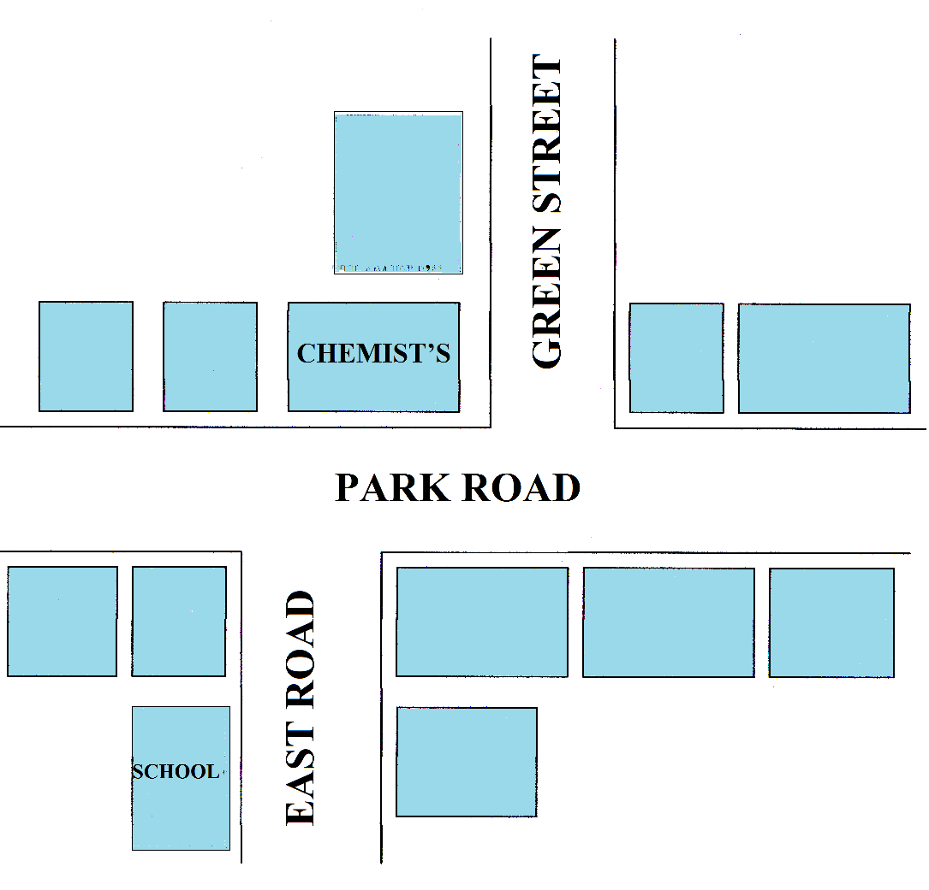

MUSEUM
CAFE
BAKER’S
SPORTS SHOP
BOOK
SHOP
CINEMA
TOY SHOP
HOTEL
LIBRARY

Slide 2
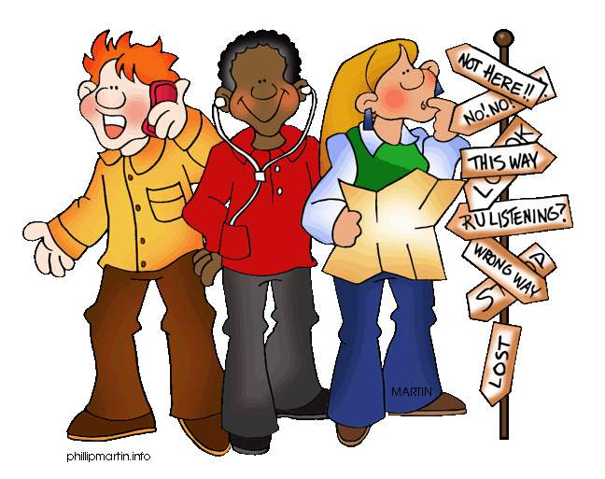
Asking and
Giving directions

Slide 3

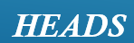
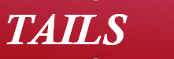


Slide 4
Just go straight road Cross the road look for a zebra crossing Stop at the traffic lights When the traffic lights turn green Walk straight across the road Turn right / turn left Go straight / down to the… | Excuse me How can I get to…? Do you know where …..is? Can I go on foot? Is it far? Could you tell me the way to…?

Slide 5
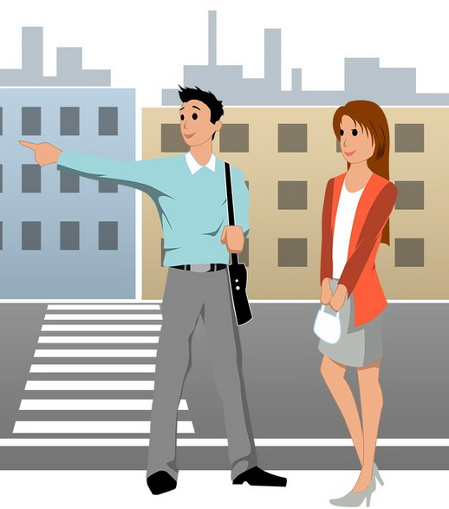

Slide 6
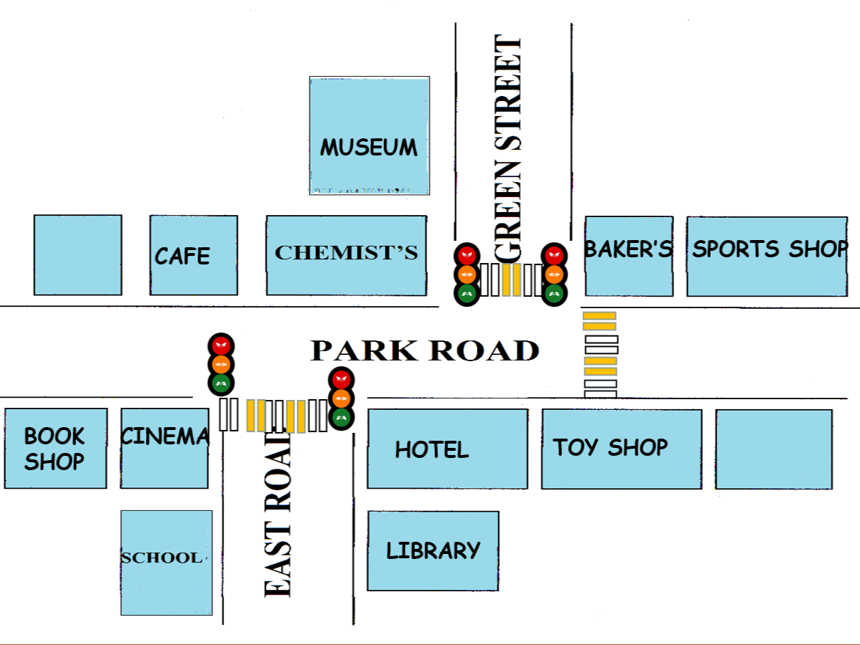



Slide 8



