Slide 1
Закревская Т.Л.
учитель английского языка
МБОУ «СОШ г. Светогорска»
Презентация к уроку по учебному предмету «Английский язык»
в 7 классе
по теме: «Сравнение школ в разных странах»

Slide 2



Wednesday
school
autumn
cool
English
lesson

Slide 3
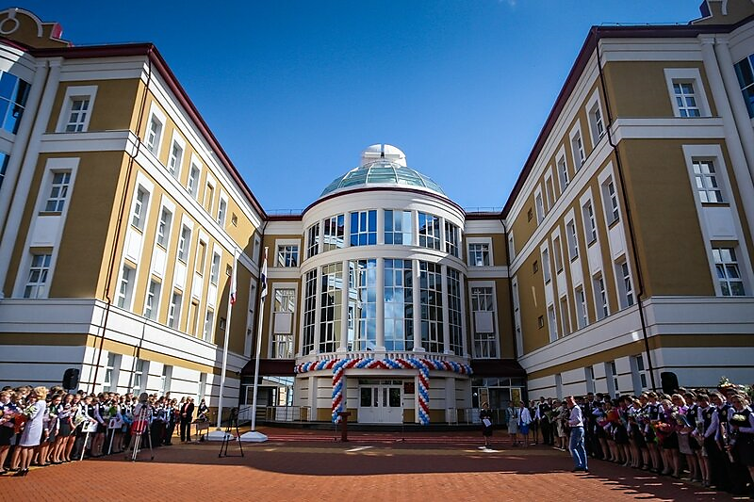
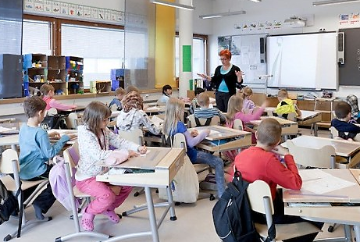


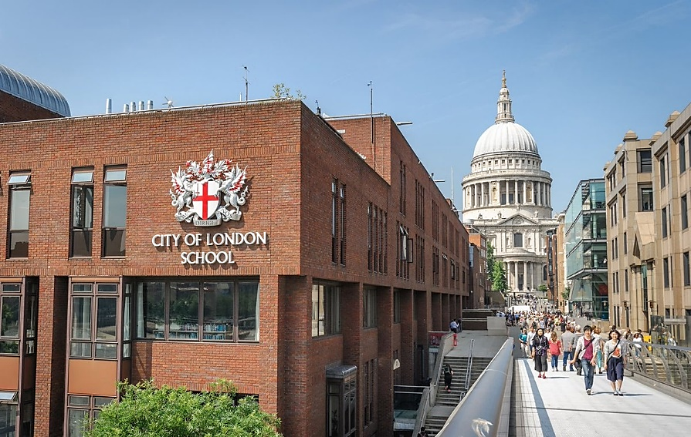

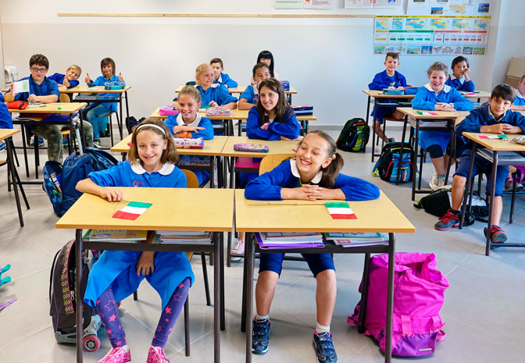
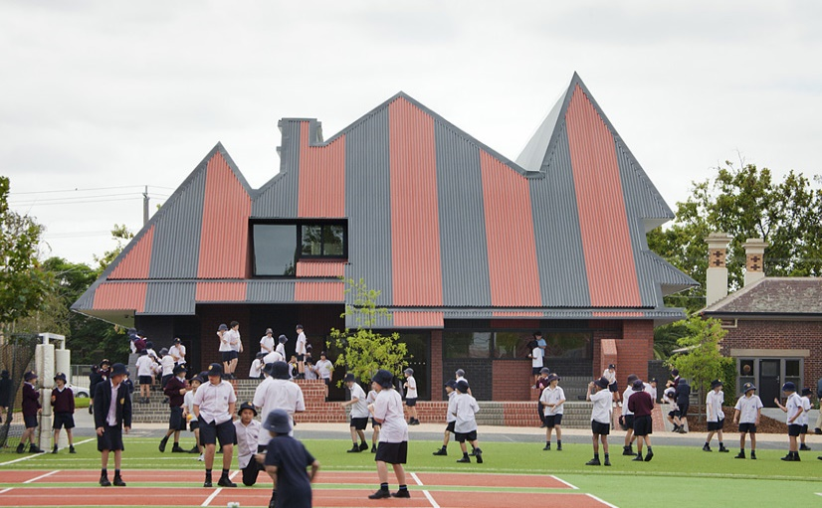


Slide 4



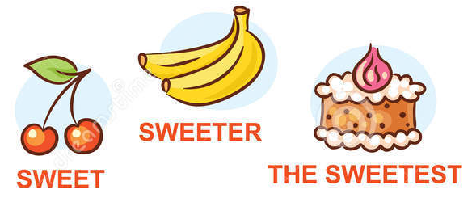


Comparing schools in different countries

Slide 5

Listen and repeat
I
primary
secondary
junior
senior
college
uniform
various
auspices
II
certificate
continual
advanced
selected
apply
III
academic
examination
education
information
attestation
mathematics
university

Slide 6

Listen and fill in the table
(Ex.1, p.4 W.B.)
Countries | School starts in | Lesson start at
Russia | September | 8.30
Japan
Thailand
Australia
Brazil
China

Slide 7
Check yourselves!
Countries | School starts in | Lesson start at
Russia | September | 8.30
Japan | April
Thailand | April
Australia | February
Brasil | February | 7.00
China | September | 7.30
Points: max – 10
10 – “5” 6-7 – “3”
8-9 – “4” 5-0 – “2”

Slide 8
Role-play
(Ex. 14 p. 9 W.B.)
Useful phrases
I stayed in … for … Holidays last for … At the age of … | You start school at … Holidays last from … to … Students study at … school for … years
School starts at … A school year is divided into …

Slide 9
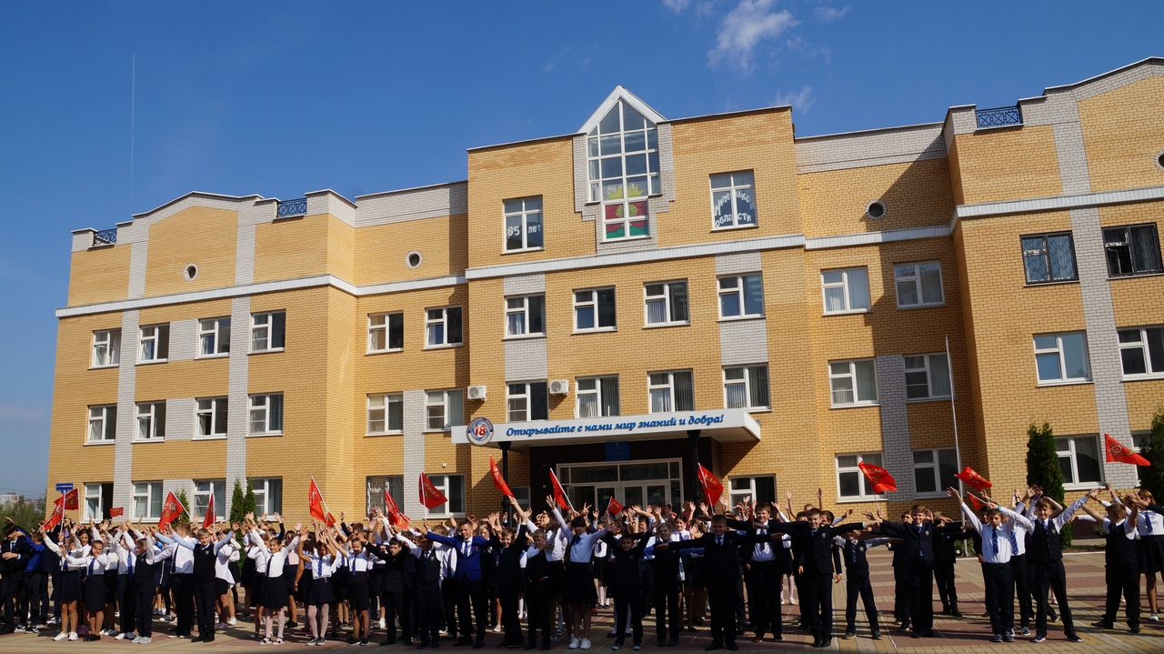
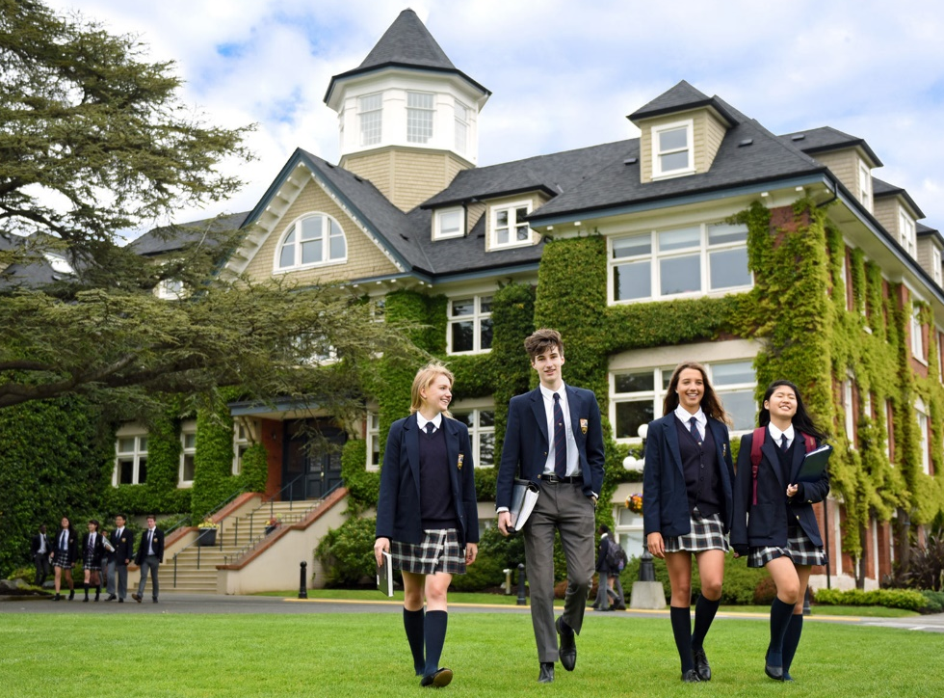
School system in Russia and in Britain

Slide 10
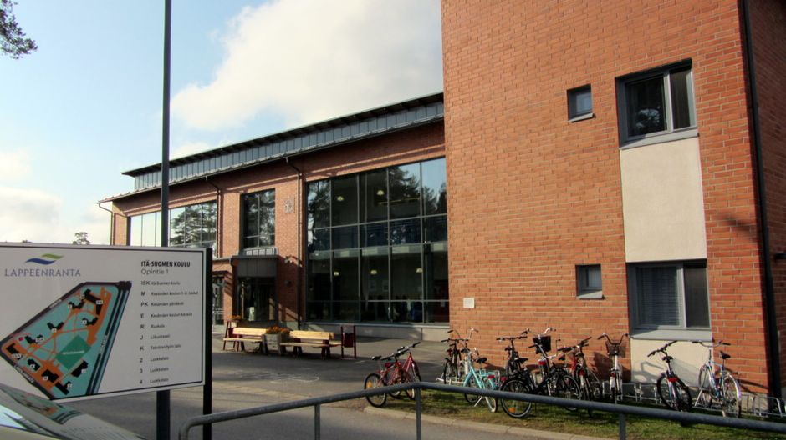
“School system in Finland”
Reading

Slide 11

Check each other!
1 – F
2 – F
3 – T
4 – T
5 – T
6 – F
Points: max – 6
6 – “5” 3 – “3”
4-5 – “4” 2-0 – “2”

Slide 12
Choose the correct form!
1. Riding a bike is ……… than swimming.
a) easy b) easier c) the easiest
2. It is ……… beautiful flower in our garden.
a) more b) most c) the most
3. My computer is better ………his computer.
a) then b) than c) ----
4. Literature is as ……..as History.
a) more difficult b) the most difficult c) difficult
5. My dog does not eat very much. He is ……..
a) fat b) thin c) nice
6. Michael looks …… than his friend.
a) older b) old c) the oldest
7. Who ………English?
a) does study b) do study c) studies
8. It ……..at the moment.
a) is rain b) is raining c) rains
9. I …….. to the park yesterday.
a) I have gone b) will go c) went
10. It …….. snow in July.
a) isn’t b) doesn’t c) is

Slide 13
1. Riding a bike is ……… than swimming.
Choose the correct form!
a) easy b) easier c) the easiest

Slide 14
2. It is ……… beautiful flower in our garden.
Choose the correct form!
a) more b) most c) the most

Slide 15
3. My computer is better ………his computer.
Choose the correct form!
a) then b) than c) ----

Slide 16
4. Literature is as ……..as History.
Choose the correct form!
a) more difficult b) the most difficult c) difficult

Slide 17
5. My dog does not eat very much. He is ……..
Choose the correct form!
a) fat b) thin c) nice

Slide 18
6. Michael looks …… than his friend.
Choose the correct form!
a) older b) old c) the oldest

Slide 19
7. Who ………English?
Choose the correct form!
a) does study b) do study c) studies

Slide 20
8. It ……..at the moment.
Choose the correct form!
a) is rain b) is raining c) rains

Slide 21
9. It …….. snow in July.
Choose the correct form!
a) isn’t b) doesn’t c) is

Slide 22
10. I …….. to the park yesterday.
Choose the correct form!
a) I have gone b) will go c) went

Slide 23
Say about your success and failure
Finish the sentences:
spoken about…
During today’s lesson I have
learnt to…
found out…
find necessary information about…
make up dialogues
Now I can
read and understand English texts
ask and answer the questions
do tests well

Slide 24
Say about your success and failure
Finish the sentences:
Grammar
Listening
Speaking
Reading
excellent
awful
quite good
difficult for me
easy for me
WAS
I would like to improve my result in…
Next lesson
I will try to speak English better
I want to get “5”

