Slide 1
Авторы: Киселева Е.Ю, учитель английского языка
Киямова З. С., учитель английского языка
МБОУ "Гимназия № 102 имени М.С.Устиновой"
Город Казань
Презентация к уроку по учебному предмету
«Английский язык»
в 6-ом классе на тему :
EXTREME SPORTS

Slide 2
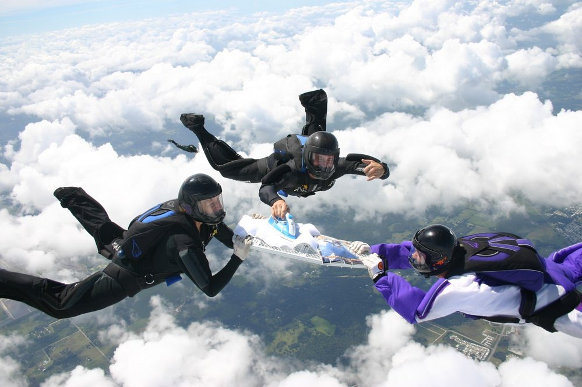
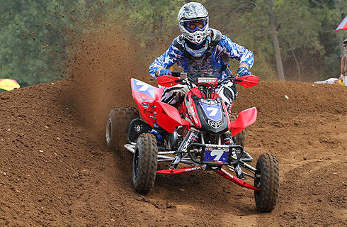
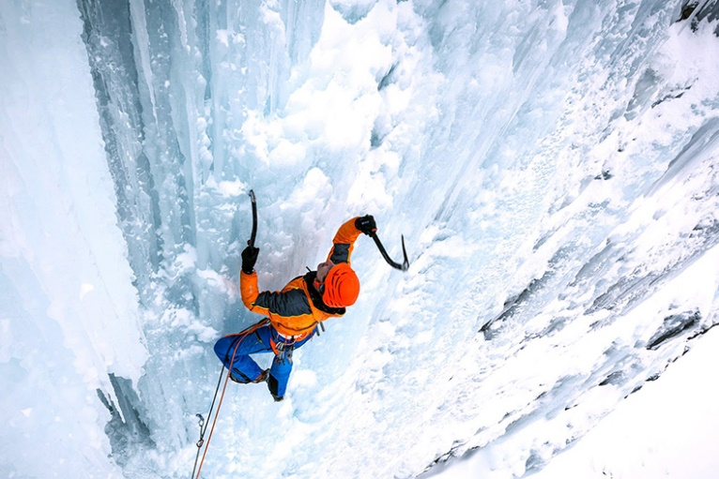
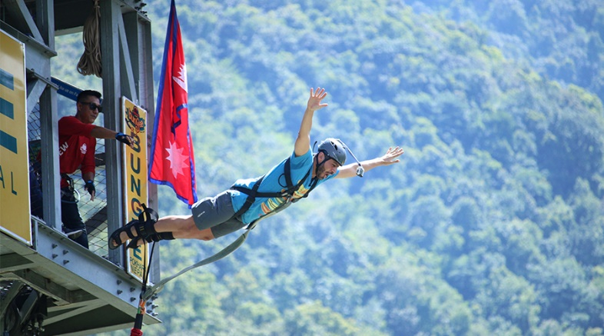
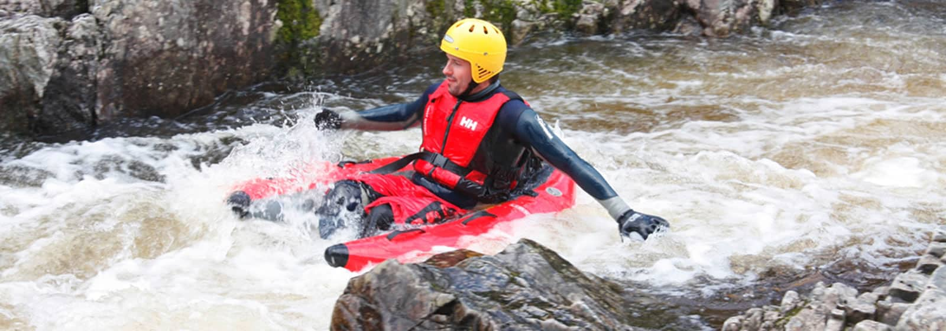
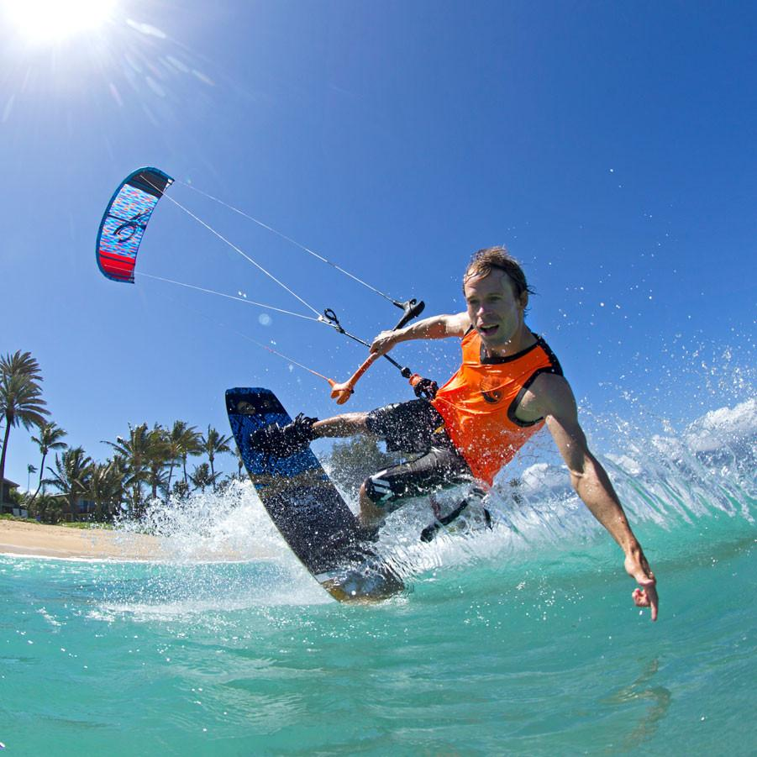
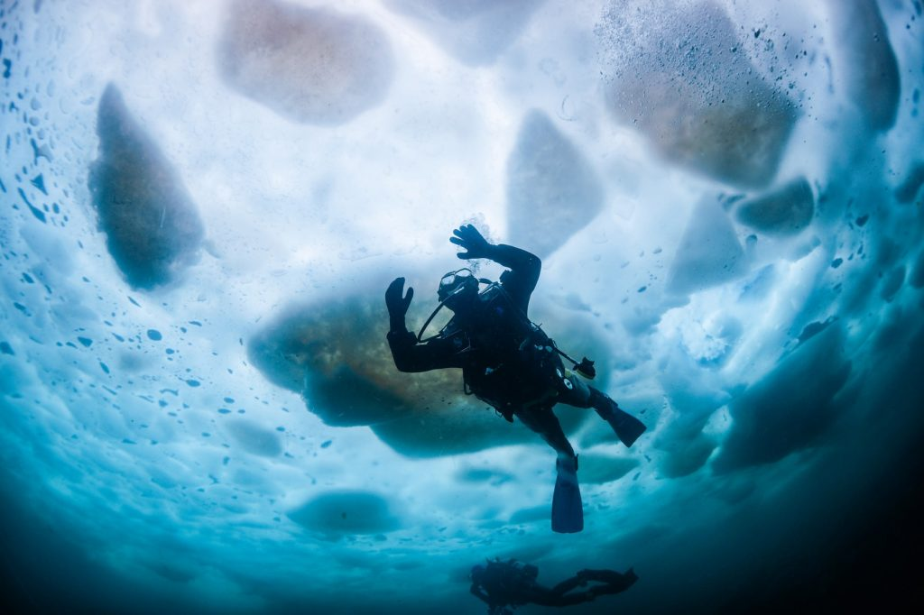
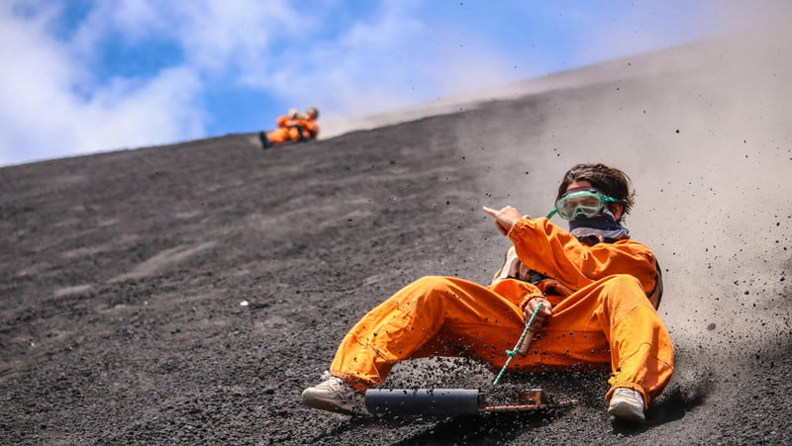
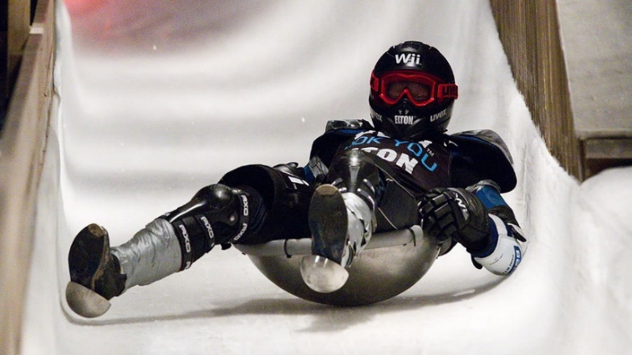
What can you say about these
activities?
https://www.themanual.com/travel/unique-winter-adventure-sports/ https://rafting.co.uk/river-bugging-scotland/ http://adventuresportsnepal.com/package/bungee-jump-in-pokhara/ http://powersports.honda.com/racing/atv.aspx https://www.themanual.com/travel/volcano-boarding-cerra-negro-leon-nicaragua/ https://www.skymonster.com/products/kitesurfing-lessons-2-days-voucher http://extreme-expedition.com/tours/ice-climbing/ http://artkomi.ru/socialnye-fototrendy-2013-selfie-bageting-i-drugie-syuzhety-dlya-socialnyx-setej/iron7 https://www.zestcarrental.com/blog/2016/11/17/ice-diving-finland/

Slide 3

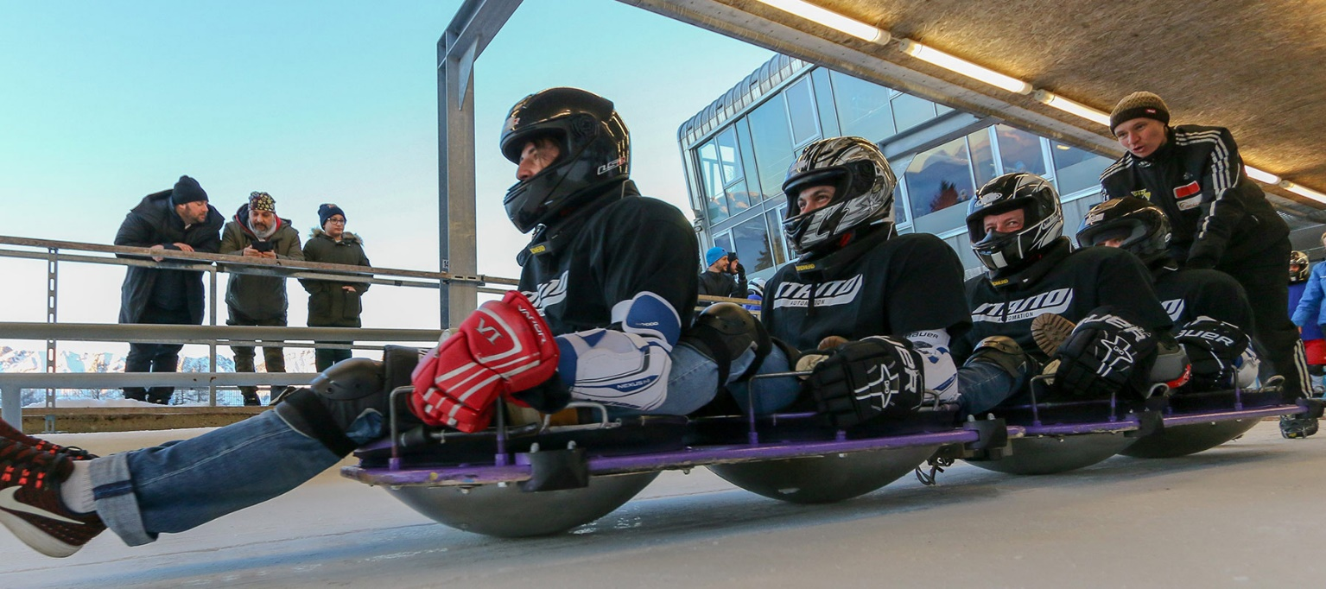
WOK RACING
https://www.themanual.com/travel/unique-winter-adventure-sports/
http://www.soccerteam.at/news/434-wok-charity-race-18-bringt-eur-3-500-00-fuer-den-help-for-kids-spendenfond

Slide 4
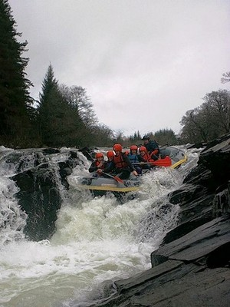
RIVER BUGGING
https://rafting.co.uk/river-bugging-scotland/
https://www.insiders-scotland-guide.com/White-Water-Rafting.html

Slide 5
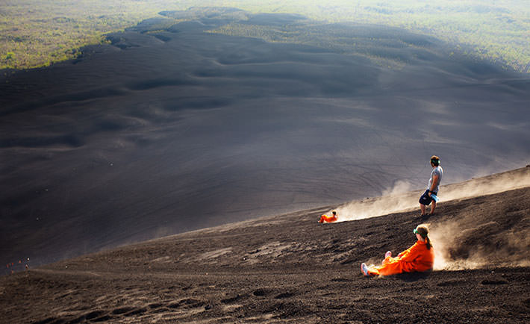
VOLCANO SURFING
https://www.themanual.com/travel/volcano-boarding-cerra-negro-leon-nicaragua/
http://www.surfranchresorts.com/2016/05/6-things-to-experience-in-Nicaragua.html

Slide 6
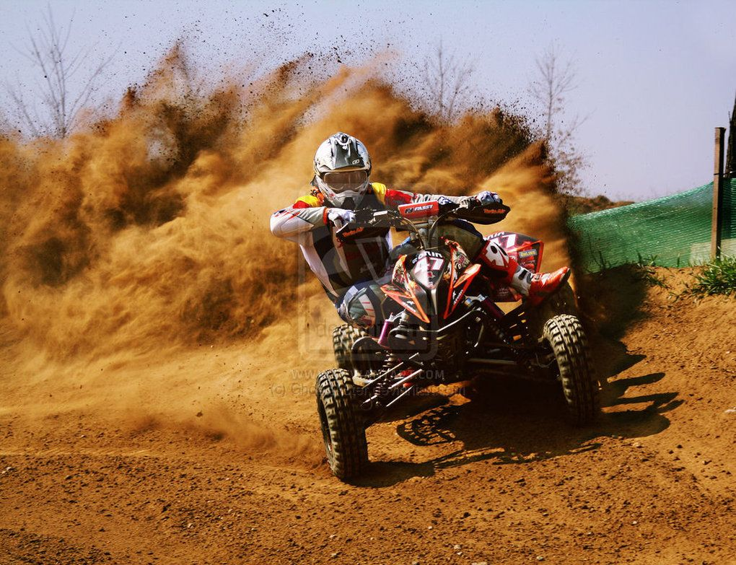
QUAD RACING
http://powersports.honda.com/racing/atv.aspx
https://www.pinterest.ru/pin/47639708533872130/

Slide 7
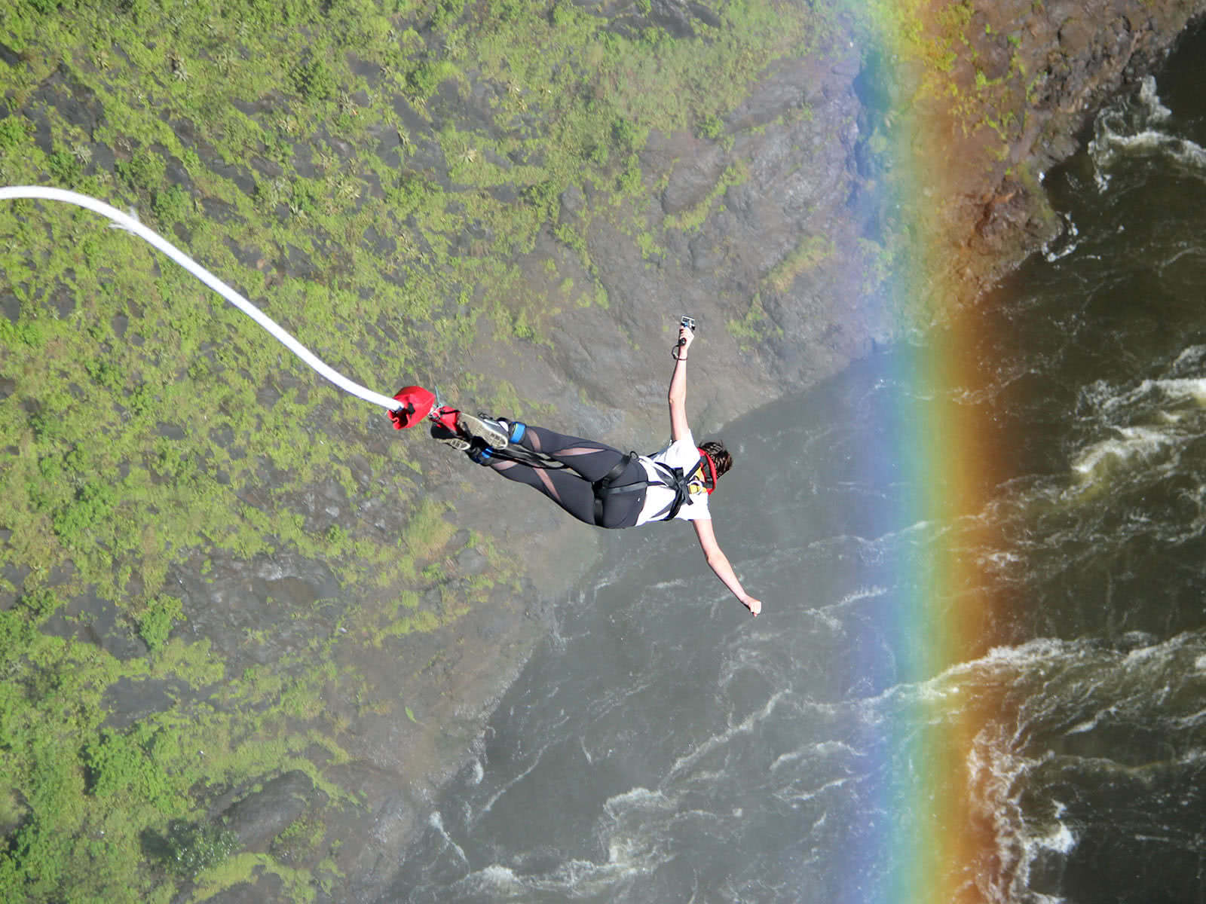
BUNGEE JUMPING
http://adventuresportsnepal.com/package/bungee-jump-in-pokhara/
https://www.pureafricaexperiences.com/destinations/bungee-jump-victoria-falls/

Slide 8
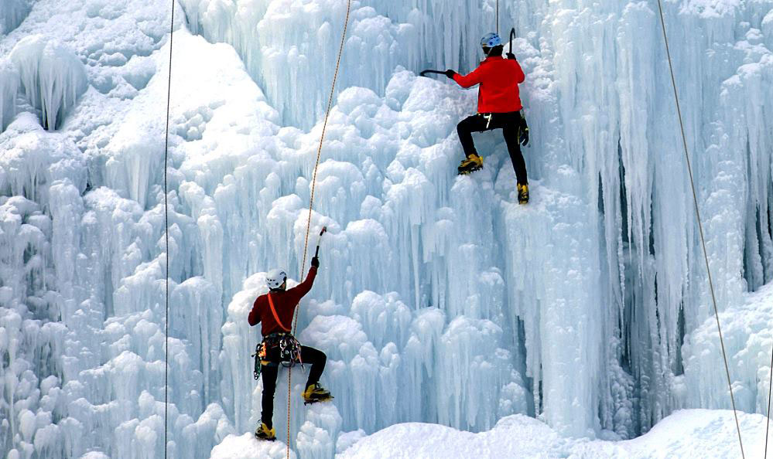
ICE CLIMBING
http://extreme-expedition.com/tours/ice-climbing/
https://303magazine.com/2017/03/ice-climbing-season-ending-reasons/

Slide 9
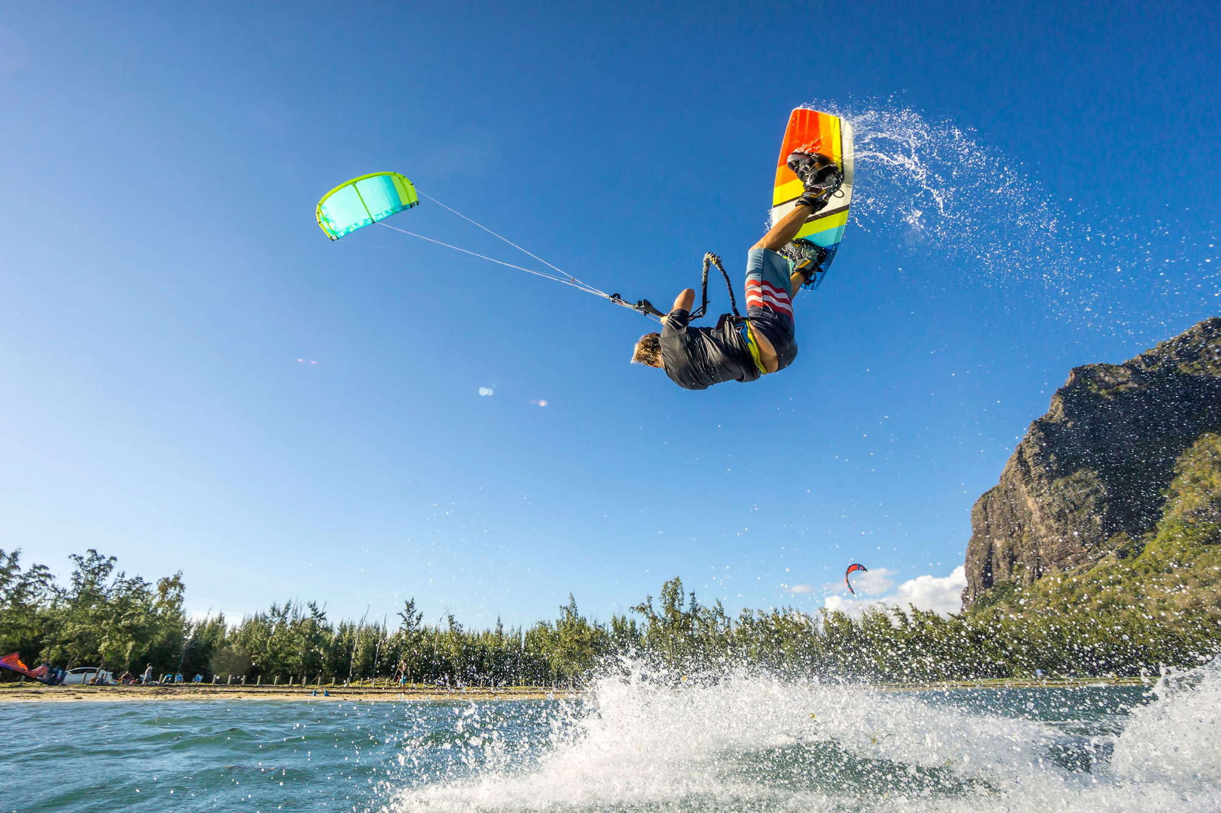
KITE SURFING
https://www.skymonster.com/products/kitesurfing-lessons-2-days-voucher
https://mpora.com/windsurfing-kitesurfing/kitesurfing-equipment-beginners-guide-essential-gear

Slide 10
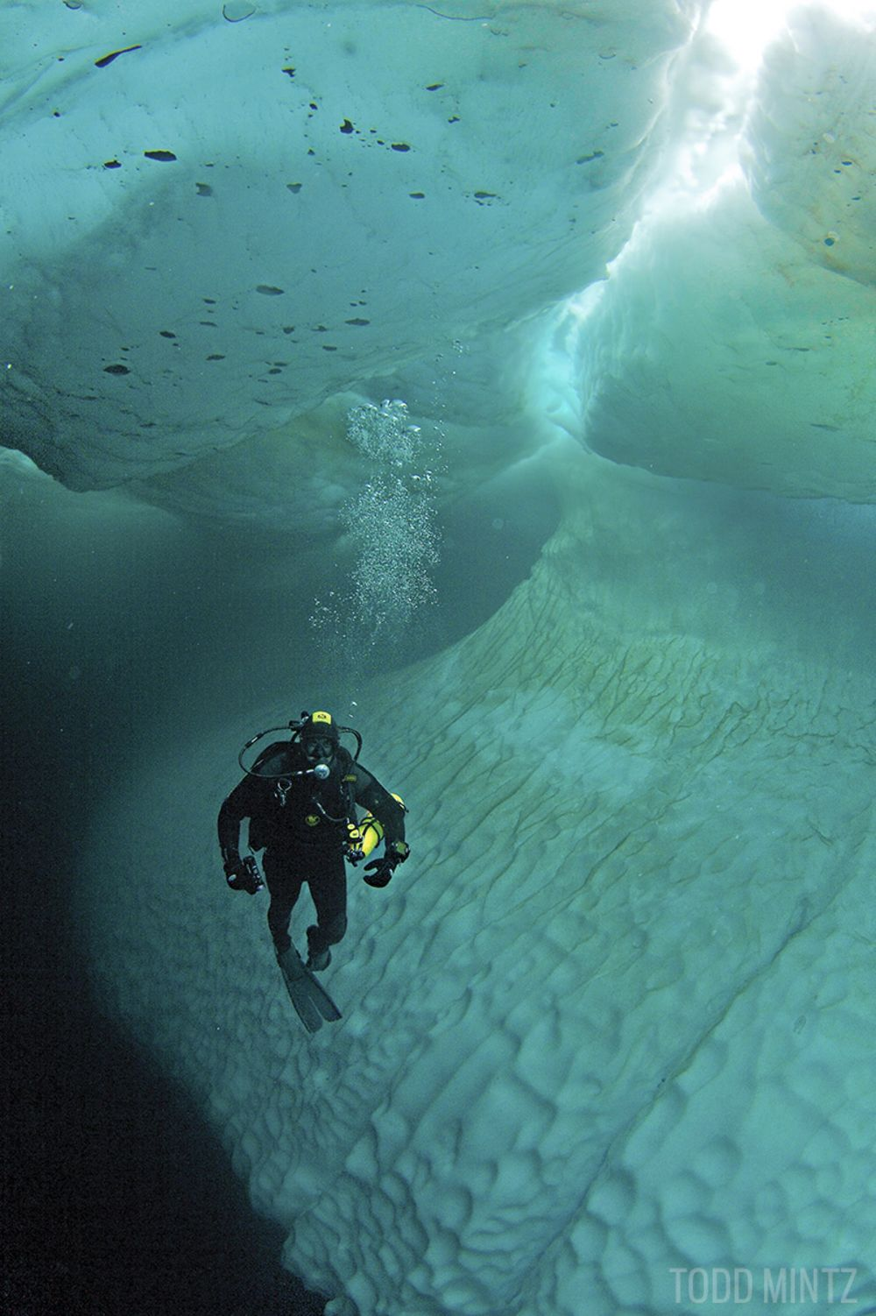
ICE DIVING
https://www.zestcarrental.com/blog/2016/11/17/ice-diving-finland/
https://www.scubadiving.com/best-ice-diving-locations

Slide 11
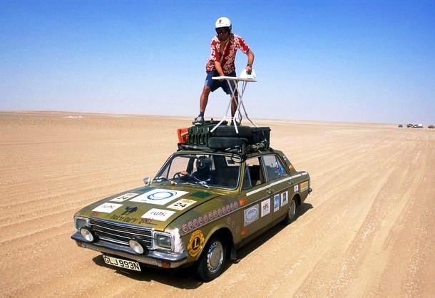
EXTREME IRONING
https://allthatsinteresting.com/bizarre-hobbies/4
https://list25.com/25-insane-examples-of-extreme-ironing/

Slide 12

Have you tried any of these sports?
Which ones do you want to try? Why?
Use the ideas in the list and any of your own ideas to tell
Ideas:
See amazing scenery
Try something thrilling
Go really fast
Spend time outdoors
Enjoy nature
Use:
I have tried................... before.
I really want to try …..... because........
I think it's …....

Slide 13
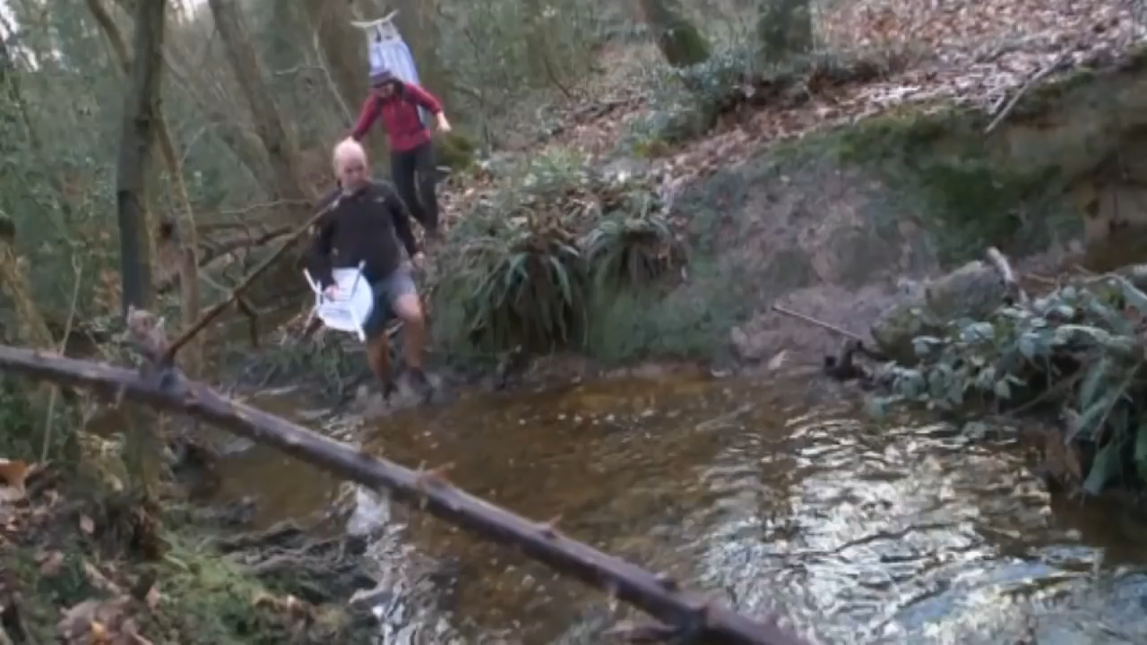
EXTREME IRONING

Slide 14
An inflatable armchair and flippers
A Chinese frying pan, a helmet and ladles
An ironing board and an iron
An ice axe and boots with metal spikes
A four-wheeled motorbike and a helmet
A board and protective clothing
A surfboard connected to a kite
An elastic rope
Extreme ironing
Quad racing
Kite surfing
Bungee jumping
Ice-climbing
Volcano surfing
River bugging
Wok racing

Slide 15
USEFUL PHRASES
Risk my life | Have always been fun
Just as crazy | For those people who are
Element of danger | absolutely crazy
I am into (skiing) myself | Risk rush
Much more dangerous | Danger is exiting
Challenging your body | You need reliable
Doing something different | equipment

Slide 16
Weird - |wɪəd| | Tip - |ˈtɪp|
Craze - |kreɪz| | Bottom - |ˈbɒtəm|
Erupt - |ɪˈrʌpt| | Complete - |kəmˈpliːt|
Ash - |æʃ| | Melt - |melt|
Protective - |prəˈtɛktɪv| | Rest - |rest|
Slope - |sləʊp| | Rapids - |ˈræpɪdz|
Speed - |spiːd| | Control - |kənˈtrəʊl|
World championship - |wəːld ˈtʃampɪənʃɪp| | Webbed gloves - |wɛbd ɡlʌvz|
Competitor - |kəmˈpɛtɪtə| | Backwards - |ˈbakwədz|

Slide 17
Weird - |wɪəd| - странный, причудливый | Tip - |ˈtɪp| - верхушка, совет
Craze - |kreɪz| - мания, увлечение | Bottom - |ˈbɒtəm| - дно, нижняя часть
Erupt - |ɪˈrʌpt| - извергаться | Complete - |kəmˈpliːt| - завершенный, заканчивать
Ash - |æʃ| - пепел | Melt - |melt| - таять
Protective - |prəˈtɛktɪv| - защитный | Rest - |rest| - отдых, отдыхать
Slope - |sləʊp| - склон | Rapids - |ˈræpɪdz| - пороги
Speed - |spiːd| - скорость | Control - |kənˈtrəʊl| - контроль, контролировать
World championship - |wəːld ˈtʃampɪənʃɪp| - чемпионат мира | Webbed gloves - |wɛbd ɡlʌvz| - перепончатые перчатки
Competitor - |kəmˈpɛtɪtə| - соперник, участник состязания | Backwards - |ˈbakwədz| - назад, в обратном направлении

Slide 18
Fill in:
Craze
Competitor
Rapid
Slope
Gloves
Boards
Axe
Erupt
Melt
Clothing
When did the volcano last................. ?
Never go volcano surfing without wearing protective …............ .
They spread salt on the road to …........... the ice.
Volcano surfing is the latest …...... in extreme sports.
The young quad racing ….... failed to show up for events.
River buggers speed along a river and down …............ .
He drove his ice …........ deep into the side of the snow- covered mountain.
A large group of divers took their ironing …..... underwater to set a world record.
Ice climbing up a steep …... is quite challenging.
Without webbed …... it is difficult to control your river bug.

Slide 19
Extremely weird!
Read the text in your books and for each gaps (1-6) choose the word that best fits
 | A | B | C | D
1 | to travelling | to travel | travel | travelling
2 | in | with | at | for
3 | it | that | their | there
4 | win | beat | come | earn
5 | see | think | feel | want
6 | what | that | there | it

Slide 20
CONDITIONALS
Zero Conditional
We use the Zero Conditional to describe rules, and situations where one even always follows the other and the laws of nature.
The pattern is:
If clause | Main clause
If + Present Simple | Present Simple

Slide 21
CONDITIONALS
First Conditional
We use the First Conditional to talk about possible future events which depend on the other future events.
The pattern is:
If clause | Main clause
If + Present Simple | Will / won’t + infinitive without to

Slide 22
CONDITIONALS
Second Conditional
We use the Second Conditional:
to talk about imagined, impossible or unlikely events in the future.
to talk about impossible or unreal present situations.
The pattern is:
If clause | Main clause
If + Past | Would / Could / Might + infinitive without to

Slide 23
EXCERCISE
Put the verbs in brackets into the correct tense. What type of conditional is each?
If you …………………… (do) more exercise, you would feel better.
If it stopped raining, we ……………………. (go) for a walk.
If I were you, I ……………………. (not go) hiking in such bad weather.
If Matt …………………. (go) hiking in the rain, he ……………………. (get) ill.
If we …………(have) a villa in the UK, we ………… (spend) our holidays there.
If the weather …........... (not get) better, we …........ (not go) to the beach.
If you …... (not wear) protective clothing when wok racing, you ….. (get) hurt.
You …... (have) better control of your river bug if you ….. (use) webbed gloves and flippers.
If you …... (like) extreme sports, you …... (love) ice climbing.

Slide 24

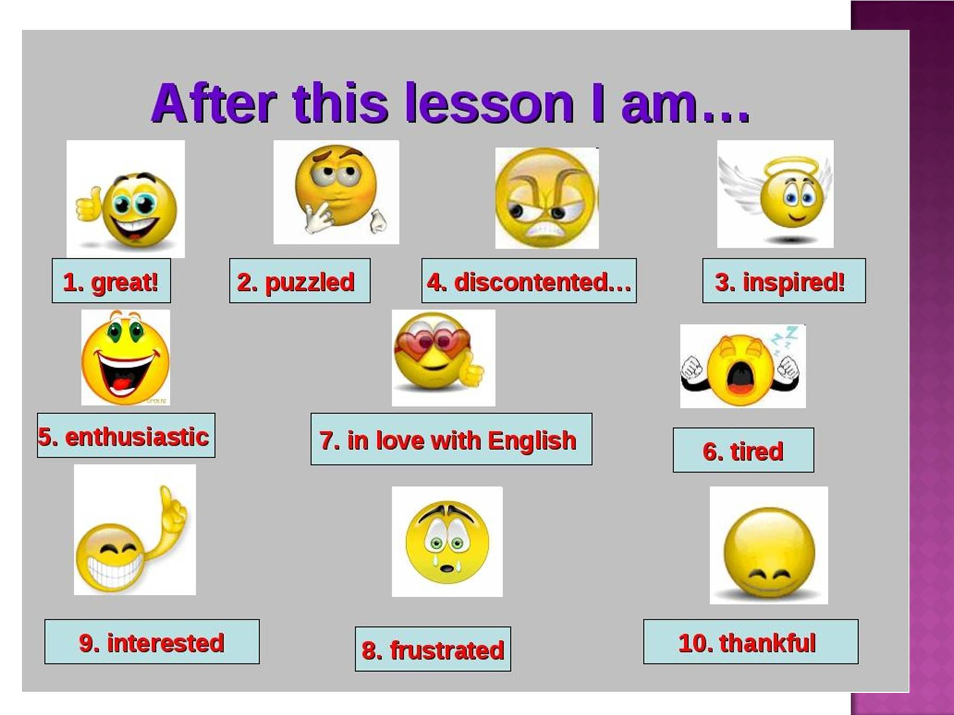

Slide 25

H/W
SB EX. 3 P. 55
Read advert B
and
write a semi-formal email
asking for more information.
Follow the plan

