Slide 1
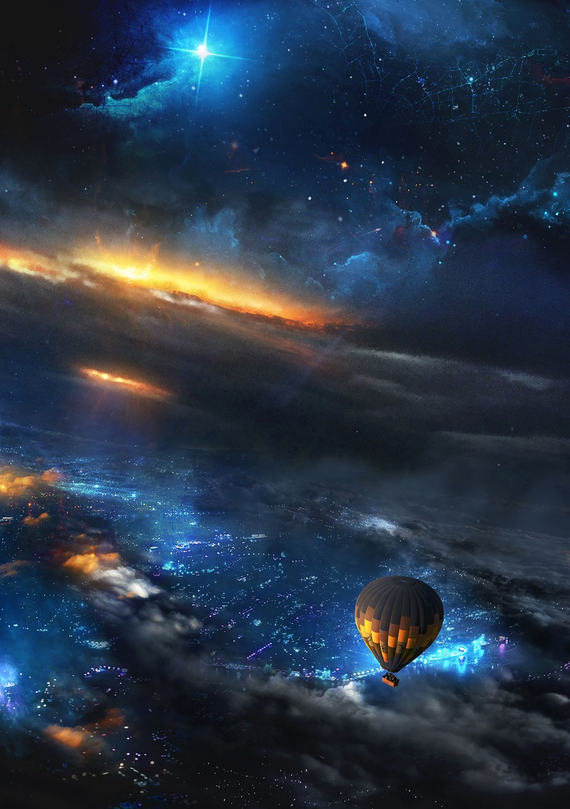
Автор: Сергутина Татьяна Владимировна учитель английского языка
КЧР Зеленчукский муниципальный район МБОУ СОШ №3 станицы Зеленчукской им. В.В. Бреславцева,
Презентация к уроку по учебному предмету «Английский язык» в 8 классе на тему:
«Мистическое путешествие в космос»
A Mystery travel through Space

Slide 2
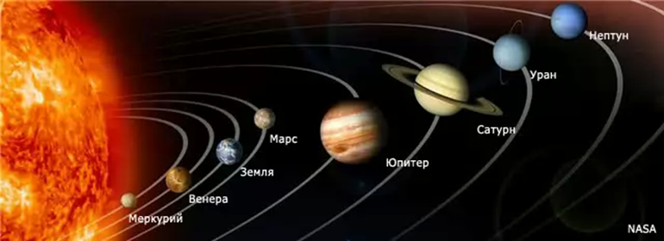
э
A Mistery Travel through Space

Slide 3
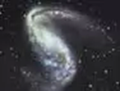

Space stations:
1. Sounds and Words
2. Guessing Words
3. Planets
4. Filling in (grammar)
5. Meeting Aliens

Slide 4
Listen to me and repeat after me then match two columns:
1. the solar system
2. the galaxy
3. the universe
4. planet
5. satellite
6. the Earth
7. the Sun
8. spaceship
9. astronaut
10. star
вселенная
Солнечная система
звезда
Земля
планета
Солнце
космический корабль
космонавт
спутник
галактика

Slide 5
1. Sounds and words: name the words with the following sounds
Words:
[ i ]-
[ s ]-
[ l ]-
[æ]-
the solar system,
galaxy
the universe
planet
satellite
atmosphere
the Sun
spaceship
astronaut
star
space
telescope
pole

Slide 6
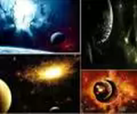
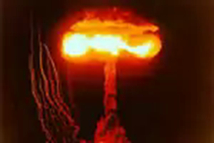
2. Guessing words: put letters in the right order
raexplotion
lagaxy
lestecope
severuni
netpla
llitetesa
nchaul
spheremoat
cesuitspa

Slide 7
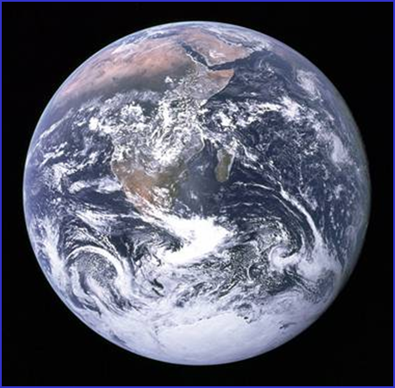
3. Planets
Listen to me and repeat after me:
Mars [ma:z]
Saturn [´sætən]
Jupiter [´ʤu:pitə]
Mercury [´mз:kjərɪ]
Neptune [´neptju:n]
Venus [vi:nəs]
Uranus [ju’reinəs]
Pluto [´plu:təʊ]

Slide 8
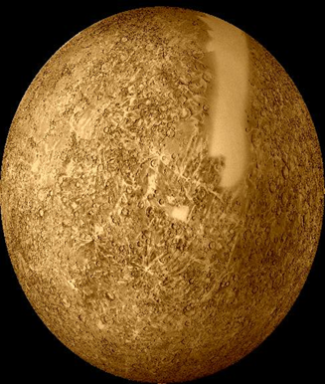
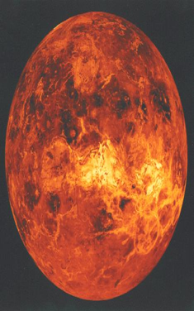
Mercury
small, covered in deep craters
Hot during the day
Cold at night
The fastest planet
Venus the hottest planet
Volcanoes
named after the god of truth and justice

Slide 9
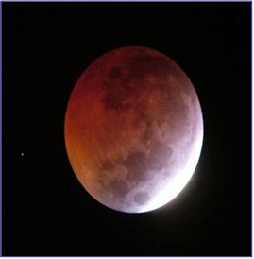
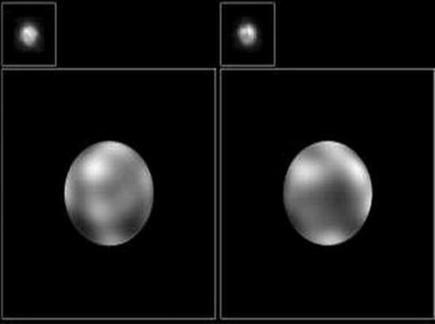
Mars
reddish sky above
the vast canyon
the fourth planet
the huge volcano
named for the god of war
Pluto
the farthest planet
strange orbit
sometimes it is closer to the sun

Slide 10
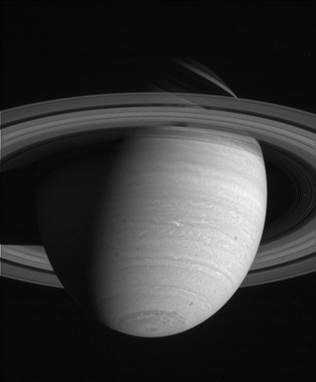
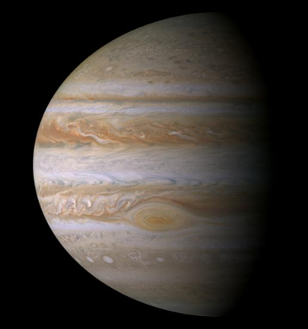
Saturn
larger than the Earth
lighter than water
has flatten poles
float in a gigantic swimming pool
Jupiter
the largest planet
stormy
spins fast

Slide 11
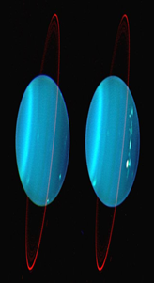
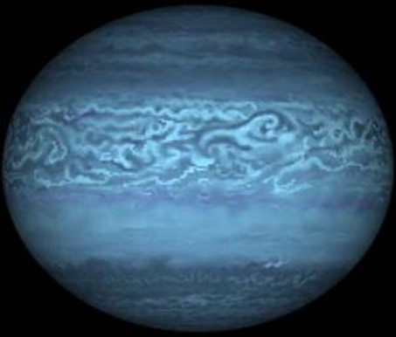
Neptune
most windy
rings and moons
has two satellites
Uranus
spins at an angle
pale blue-green cloudy atmosphere
15 moons and two rings
42 years of sunlight
42 years of darkness

Slide 12
4. Revise grammar:
Present Perfect Continuous
Present Perfect
have
has + (V+ed)
V3
have
has +been +Ving

Slide 13
Explain the rules of usage:
1.Present Perfect:
I’ve listened to your disk. It’s really good.
2. Present Perfect Continuous:
I’ve been listening to a new disk for a week . I’m enjoying it.

Slide 14
Explain the following facts. Use the Present Perfect or the Present Perfect Continuous
• John is on board a spaceship. He is very happy. - (dream about space flights since childhood)
• Martin is glad. – (discover a new star)
• Russia is one of the most advanced space countries. - (do research in space for many years)
• Jack’s father is a famous spaceman. - (work on orbital stations twice)
• The 12th of April is a well-known holiday in Russia. - (be celebrated as Space Day since 1961)

Slide 15
Listen to the dialogue, complete the following sentences:
1. Ann. And s….billions of dollars on s…..research. This money should be used for medical r…….
2. Felix. By space e…….one day we may find another p…… that we can l…..on. We must learn to t…….not only about this g…..but about f……..generations as well.
3. Linda. Would we a…….to ruin another p………..for our needs? Of course, we w………People will think that there is another planet for us in s…………

Slide 16
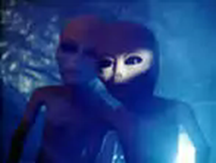
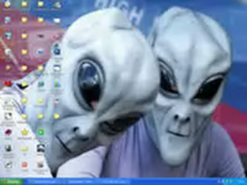
5. Meeting Aliens
Act out your dialogues, using the following:
sustenance
germs
Earth life forms
spaceship
communicate
investigation
mind
Humans
stars
Moons

Slide 17
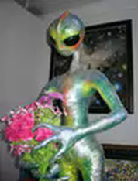
Homework :
Ex73 p.22 read and translate
p.37 words learn by heart.

Slide 18
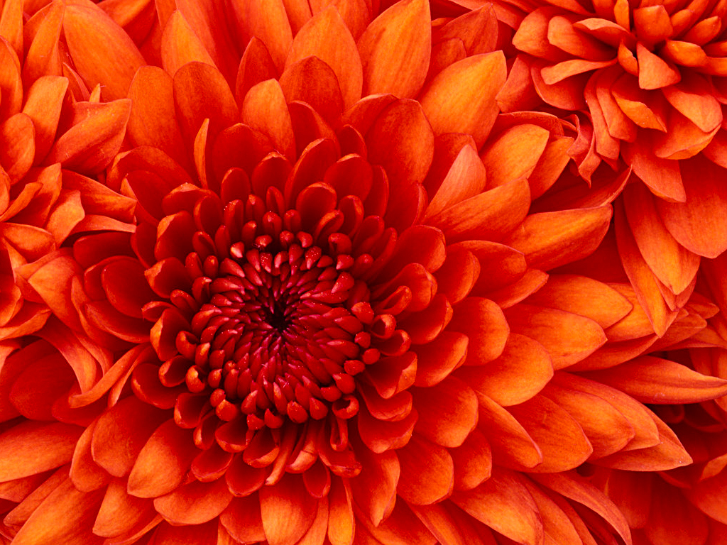
Thank you for attention

