Slide 1
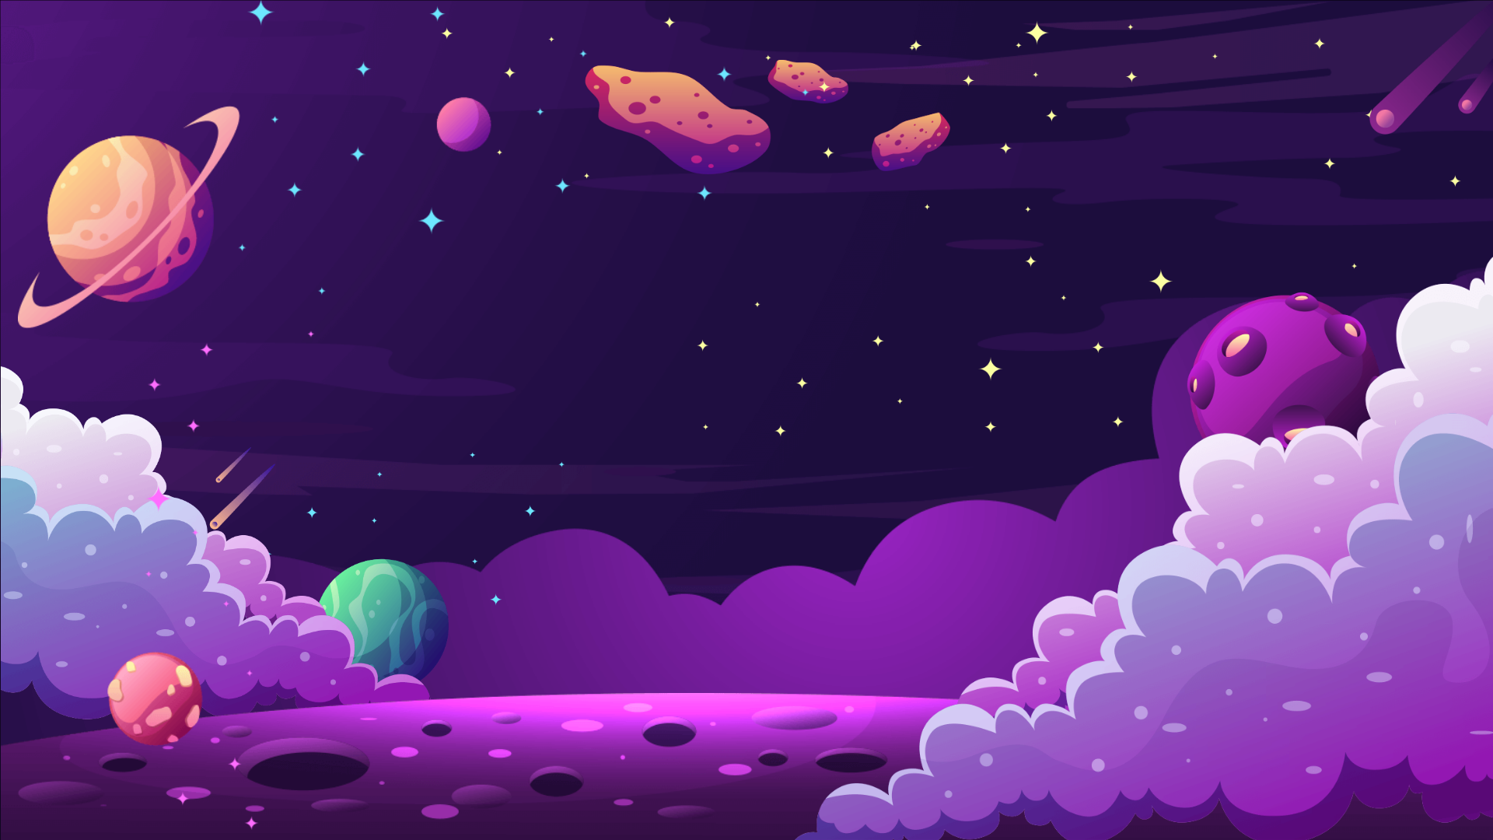
Презентация к учебному предмету английский язык в 1 классе на тему “Solar System”
Килина Виктория Дмитриевна и Федорова Светлана Владимировна,
учителя английского языка, ЧОУ “Газпром Школа Санкт-Петербург”

Slide 2
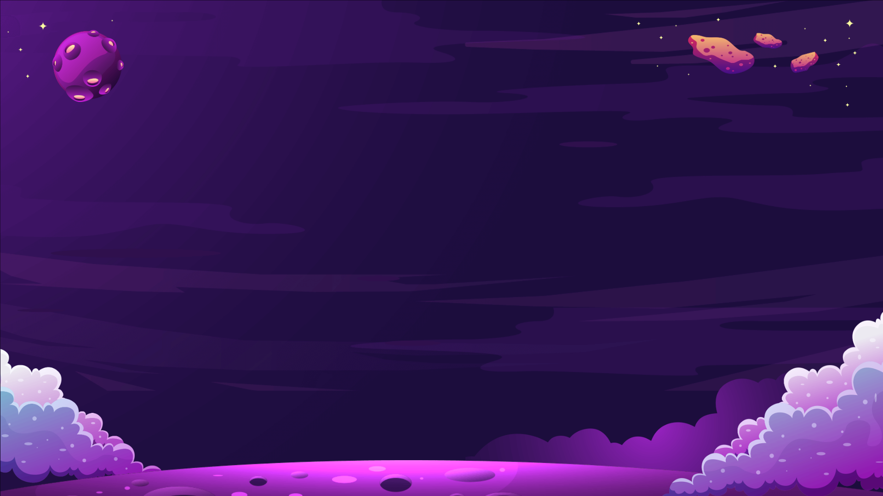
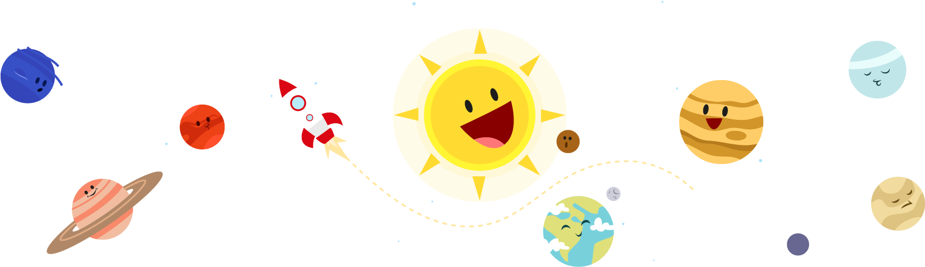
What can you see?
PLANETS

Slide 3
SOLAR SYSTEM
What can you see?

Slide 4


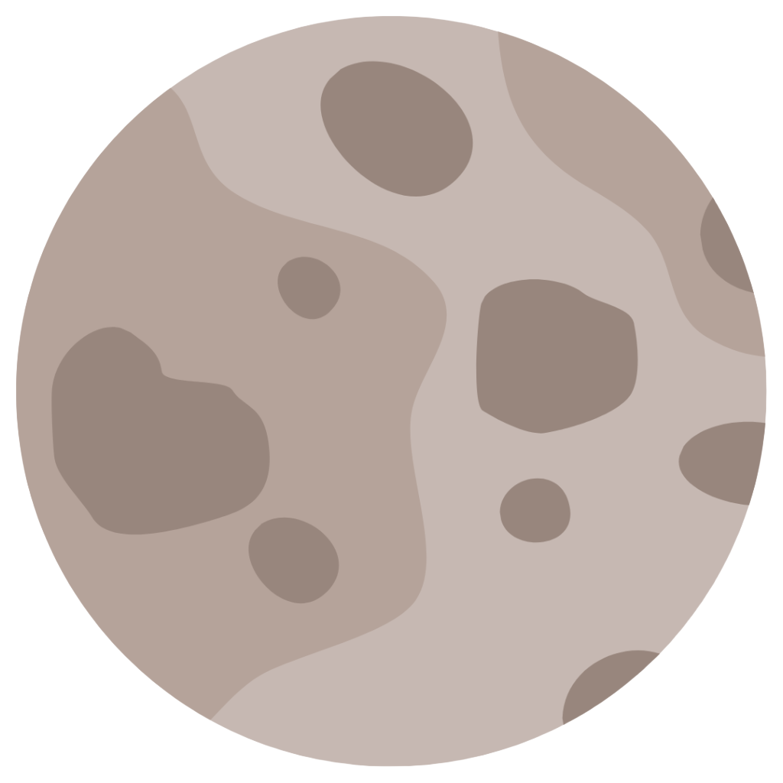
Planets can be:
small
medium
big

Slide 5
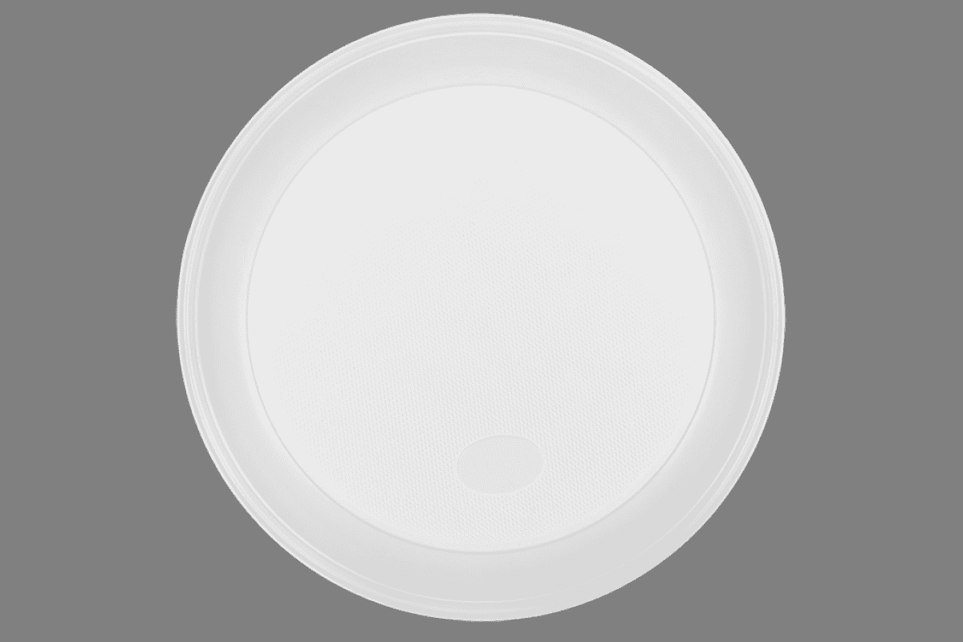
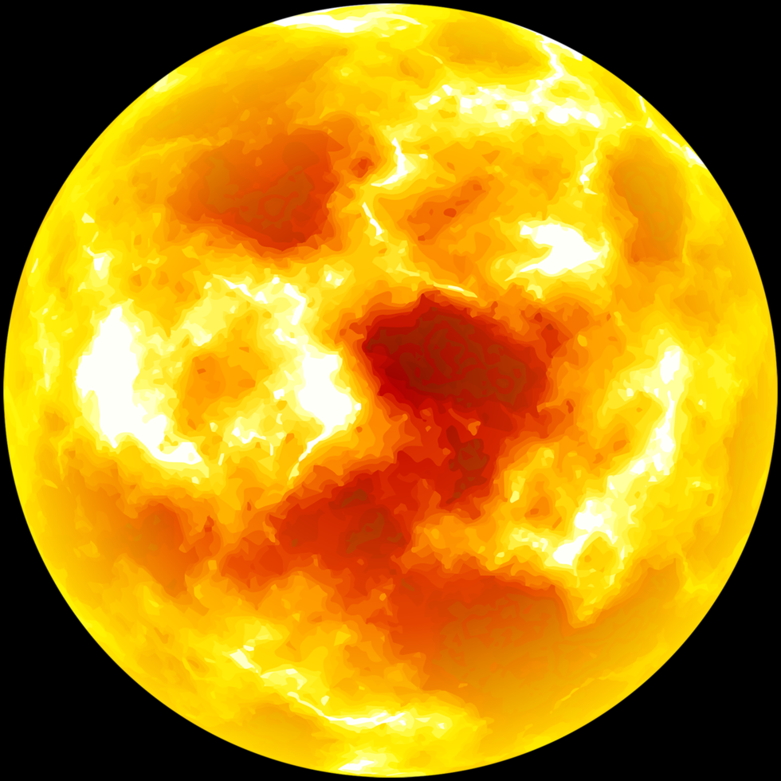
The Sun
It`s a star.
It`s big.
It`s yellow.

Slide 6
Mercury
It`s a planet.
It`s small.
It`s grey.

Slide 7
Venus
It`s a planet.
It`s medium.
It`s yellow and white.

Slide 8

Earth
It`s a planet.
It`s medium.
It`s blue and green.

Slide 9
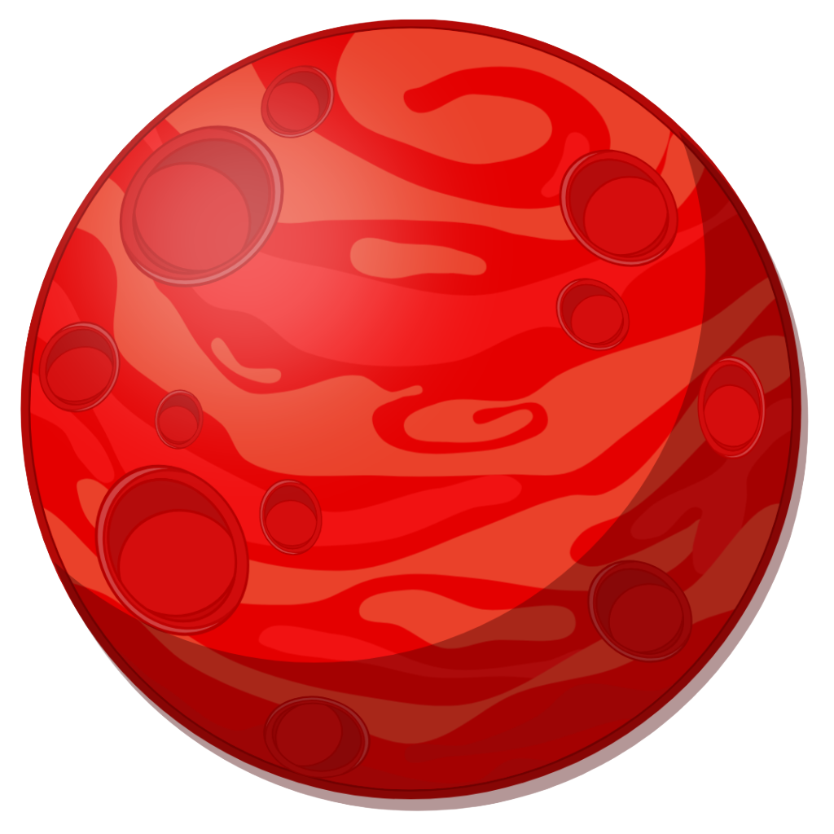
Mars
It`s a planet.
It`s small.
It`s red.

Slide 10

Jupiter
It`s a planet.
It`s small.
It`s orange and white.

Slide 11
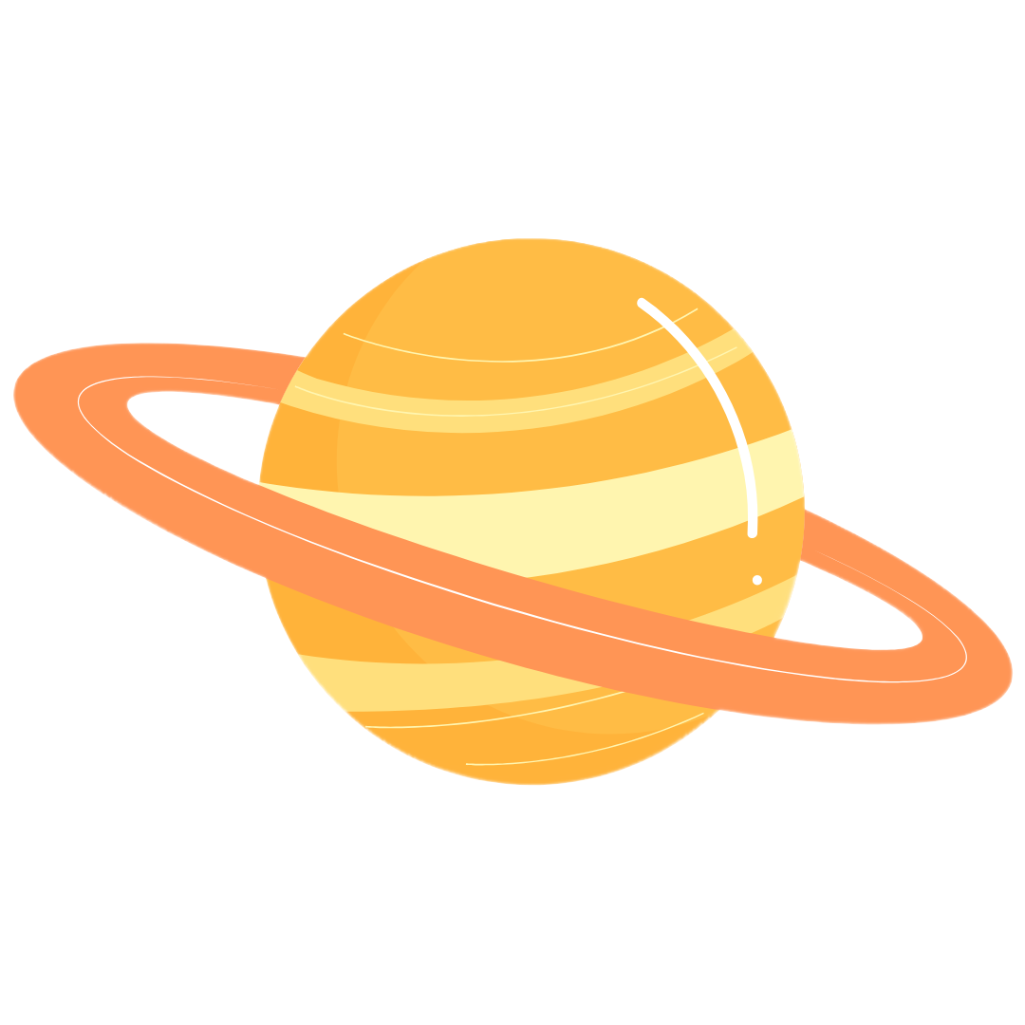
Saturn
It`s a planet.
It`s big.
It`s yellow.

Slide 12
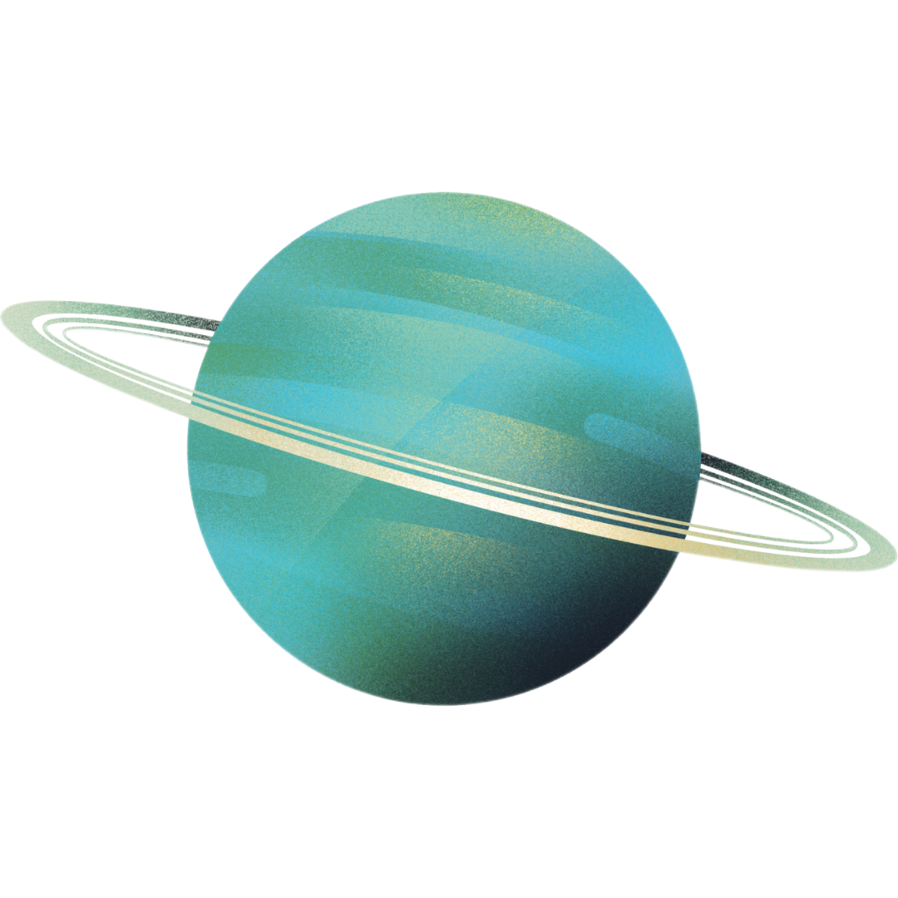
Uranus
It`s a planet.
It`s small.
It`s blue and green.

Slide 13
Neptune
It`s a planet.
It`s big.
It`s blue.

Slide 14

Watch the video

Slide 15
How many planets are there in the Solar System?
8 PLANETS

Slide 16
What planets do you know?
Mercury, Venus, Earth, Mars, Jupiter, Saturn, Uranus, Neptune

