Slide 1

Презентация к уроку по учебному предмету «Английский язык»
в 5-ом классе на тему:
«My family»
подготовили
Учителя английского языка
Смирнова Валерия Сергеевна,
Трапизон Ирина Владимировна
МБОУ СОШ №36 г. Белгорода
2025 год

Slide 2
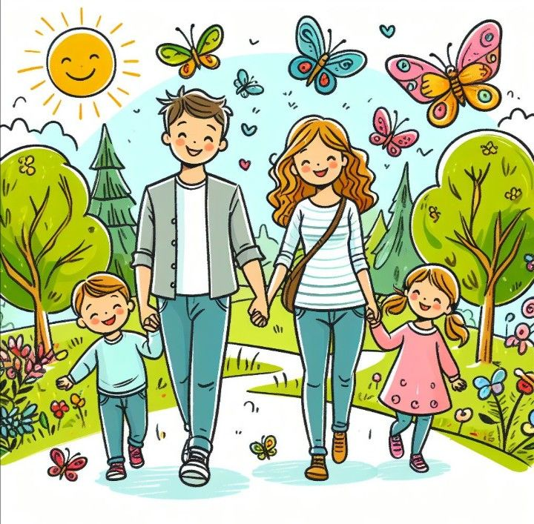
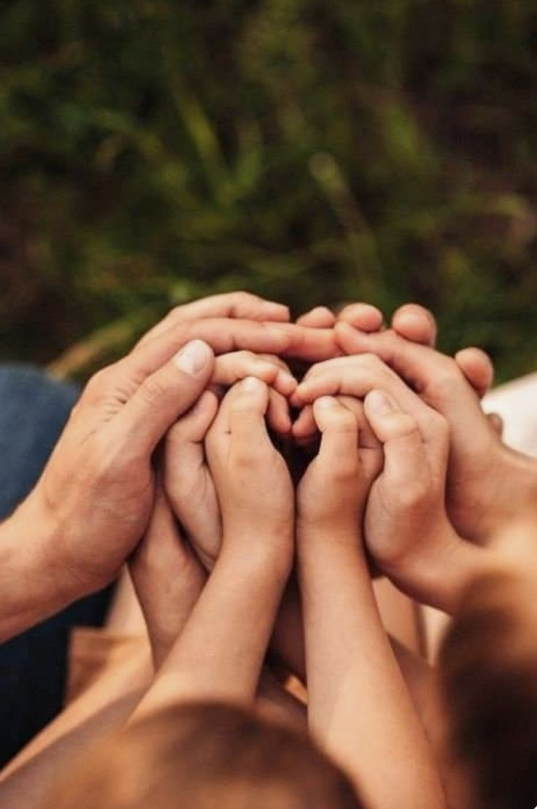
Let's practice
I have a father.
I have a mother.
I have a sister.
I have a brother.
Father, mother, sister, brother
-Hand in hand with one another.
Some families are large.
Some families are small.
But I love my family
Best of all!

Slide 3

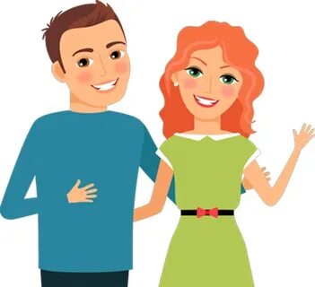
Let's get acquainted
P a r e n t s
Father
Mother

Slide 4
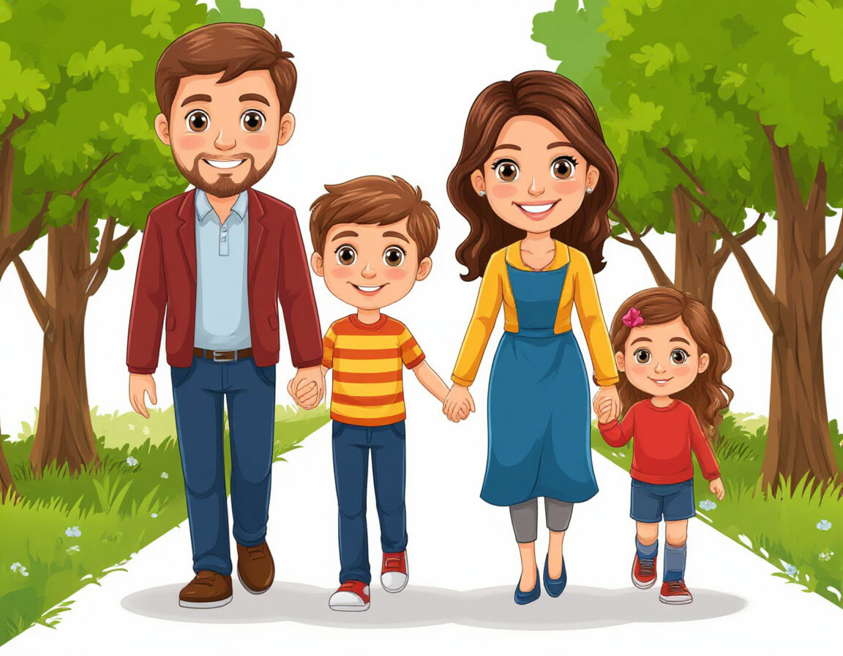
Children
Son
Daughter

Slide 5
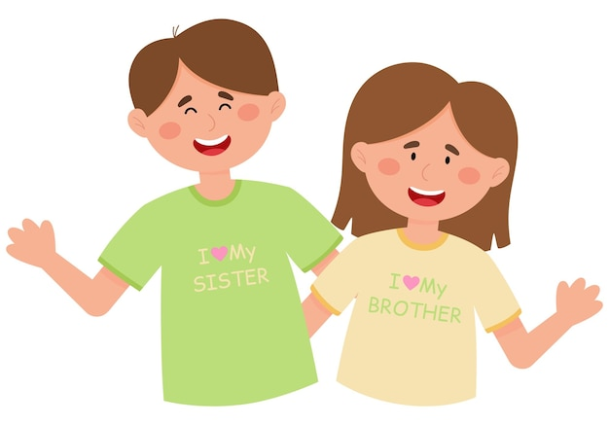
Siblings
Brother
Sister

Slide 6
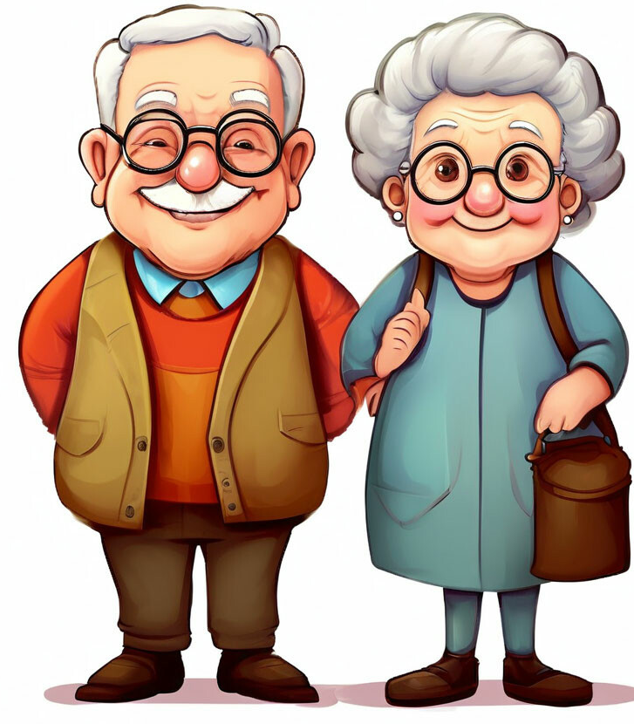
Grandparents
Grandfather
Grandmother

Slide 7
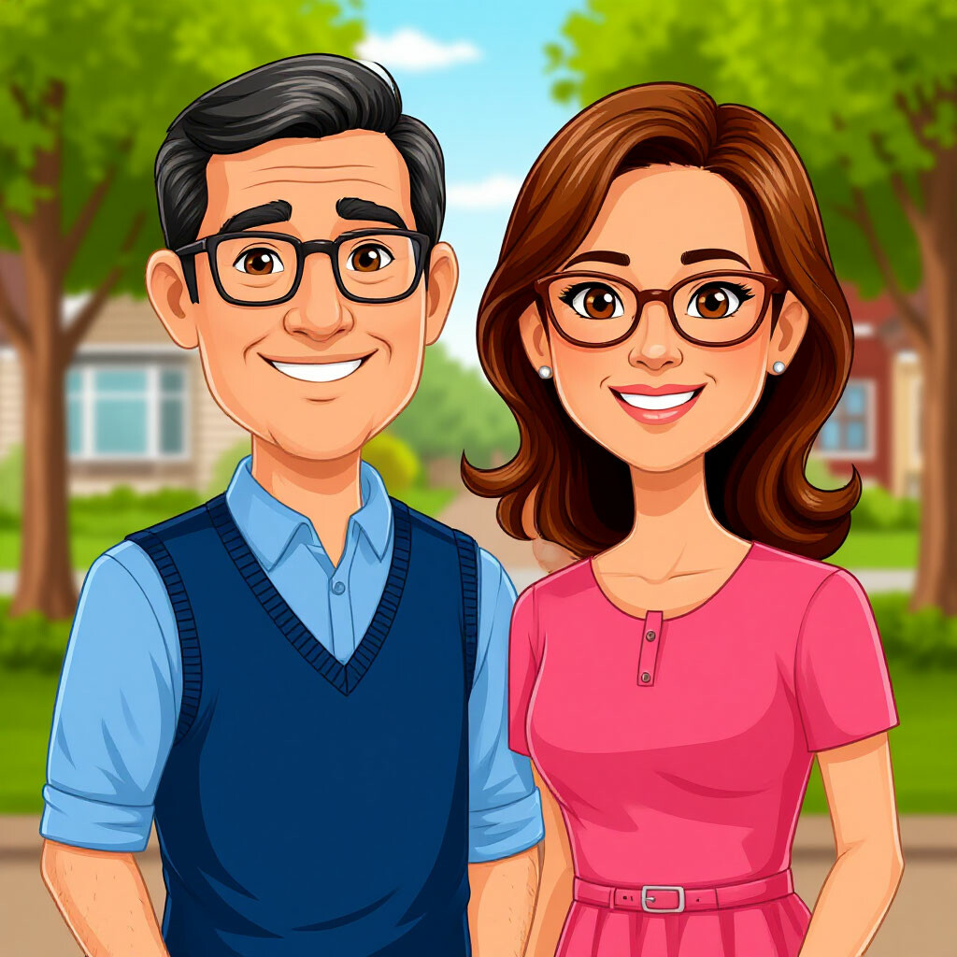
Uncle
Aunt

Slide 8
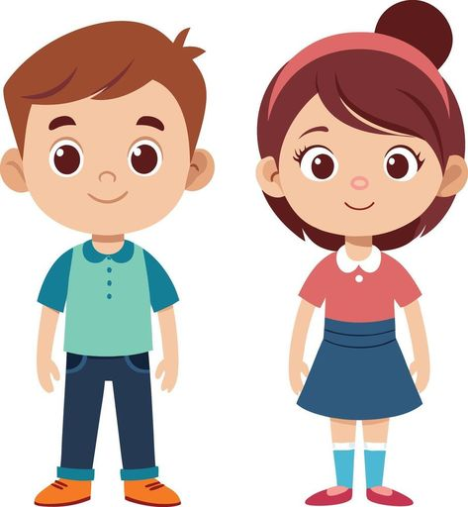
Nephew
Niece

Slide 9
Guess: W h o ?
This is my mother's brother.
This person is my brother's daughter.
She is my father's mother.
This person is my mother's sister.
This person is my mother's father.
We are brother and sister to each other.
This person is my sister's son.
Uncle
Niece
Grandmother
Aunt
Grandfather
Siblings
Nephew

Slide 10
Unscramble the words
Check yourself
ATTENTION!
These are the right answers
MOTHER
FATHER
SISTER
BROTHER
UNCLE
CHILDREN
SON
DAUGHTER
1. RMOETH
2. RFETHA
3. TERISS
4. RBOHTER
5. ECLUN
6. DNIHCLER
7. SNO
8. HGRADUTE

Slide 11

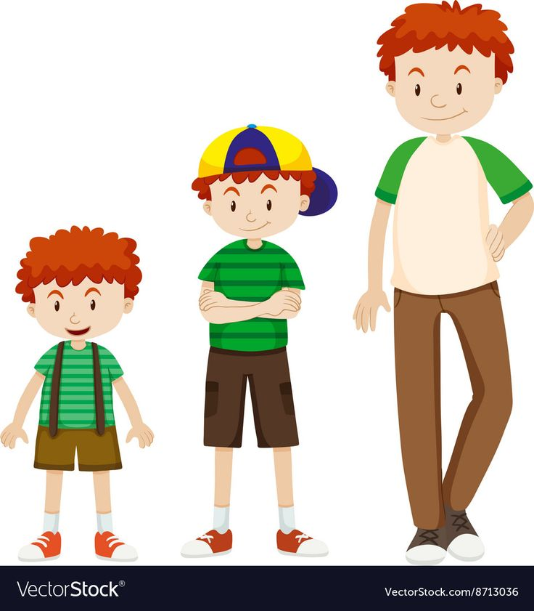
Description of appearance
HEIGHT
TALL
MEDIUM-HEIGHT
SHORT

Slide 12
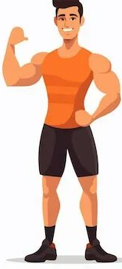
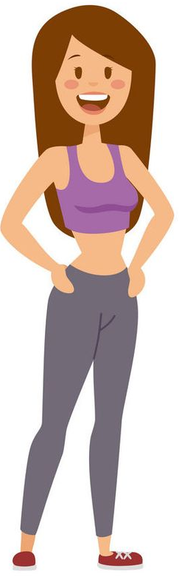
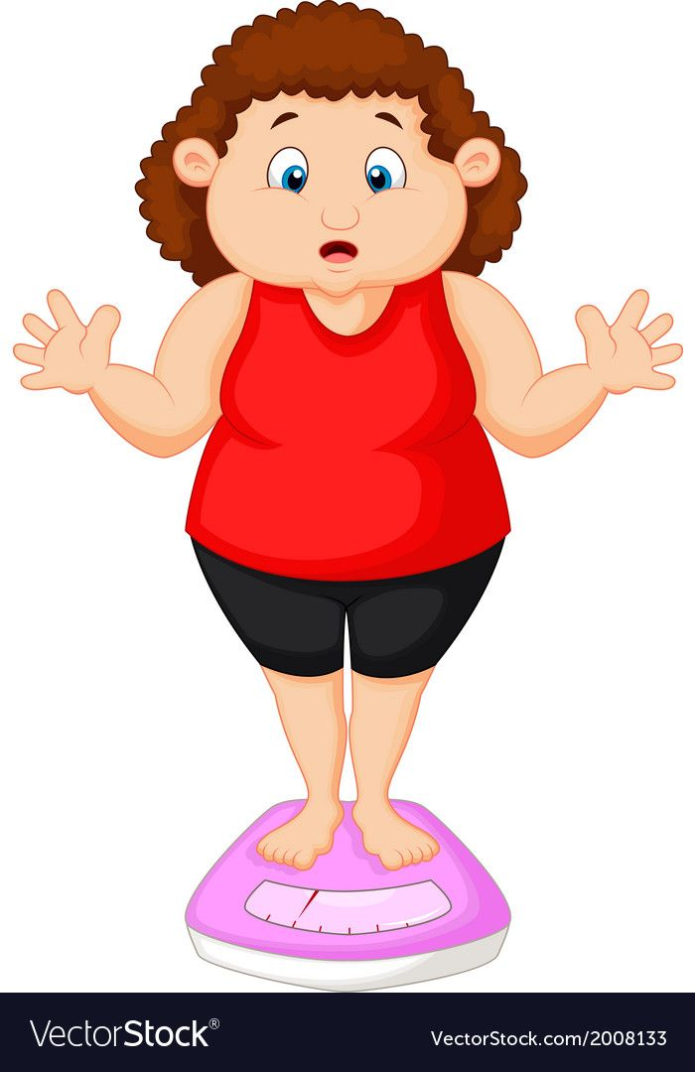
WEIGHT
FIT
THIN
FAT

Slide 13

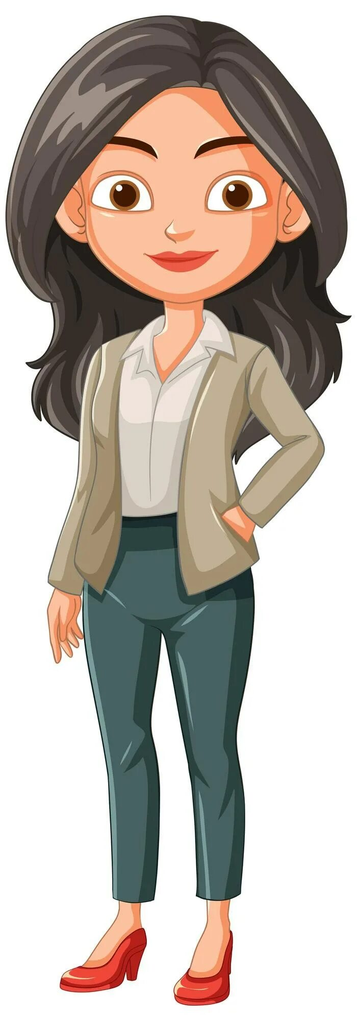
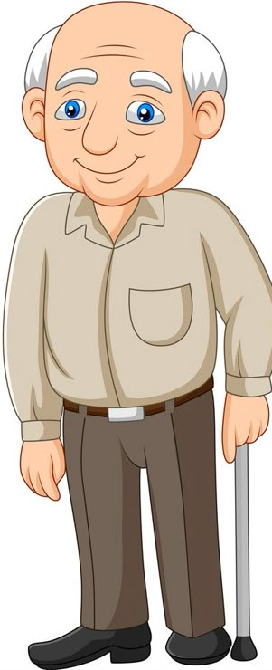
AGE
OLD
YOUNG
MIDDLE-AGED

Slide 14
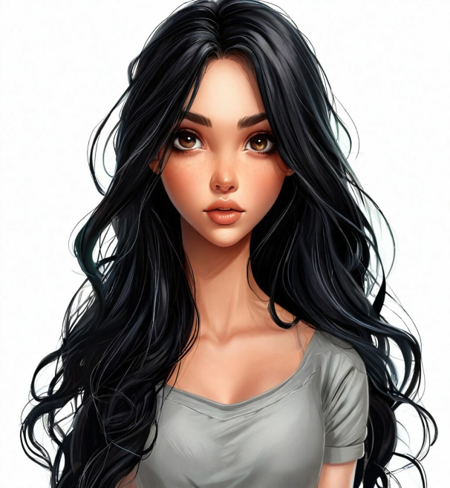
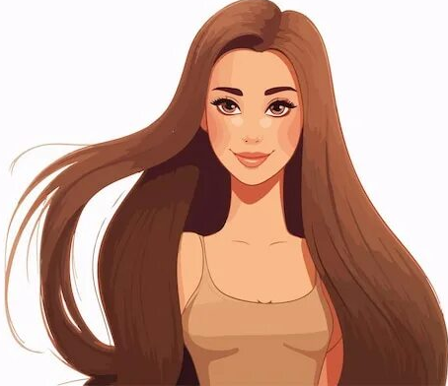
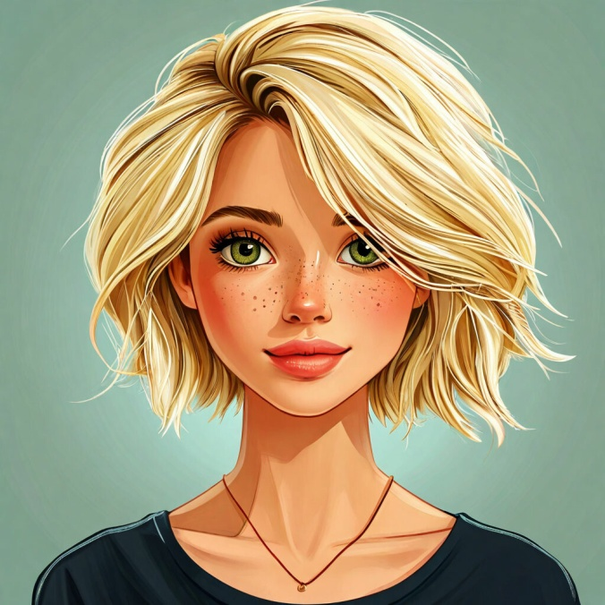
HAIR
DARK,
WAVY
BROWN,
STRAIGHT,
LONG
FAIR,
SHORT

Slide 15



EYES
SMALL
BIG
GREEN
BLUE
BROWN

Slide 16


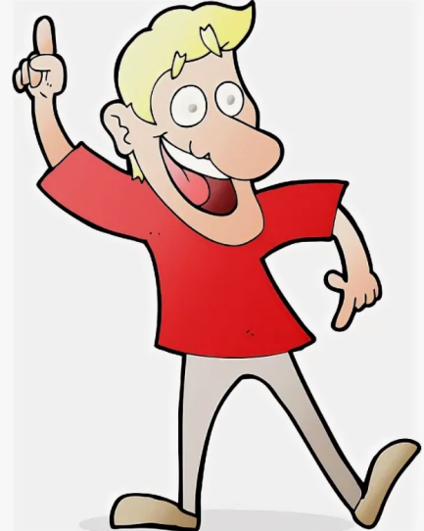
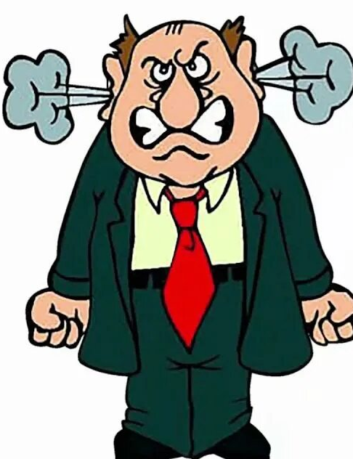
Personality traits
Clever
Kind
Friendly
Nice
Funny
Naughty
Angry

Slide 17
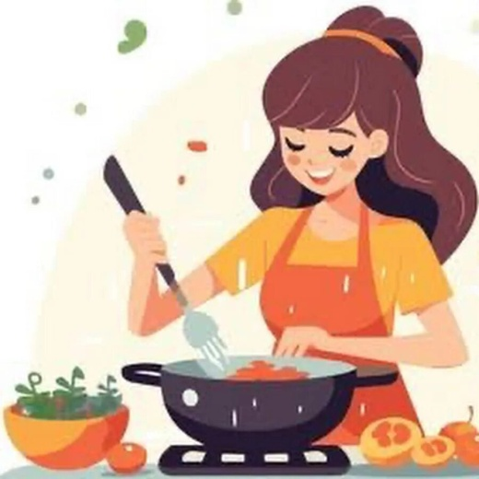

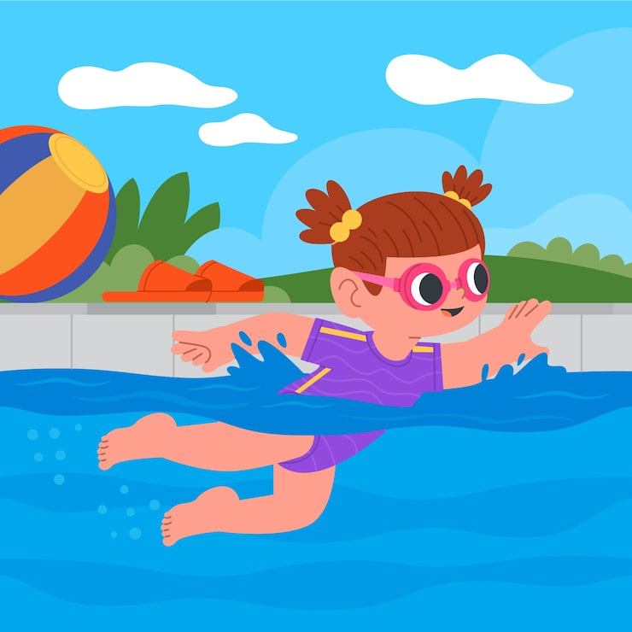
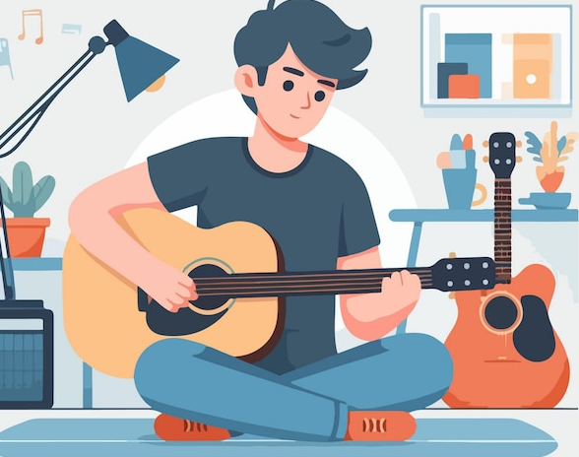
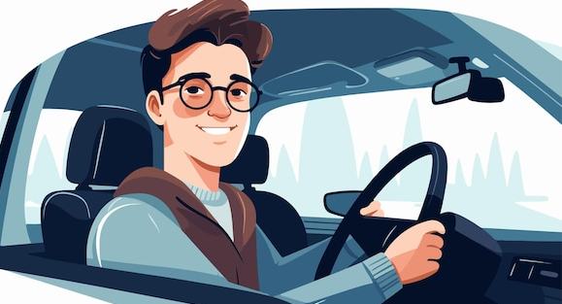
She/He can or can’t
Cook
Sing
Dance
Swim
Play the guitar
Drive a car

Slide 18

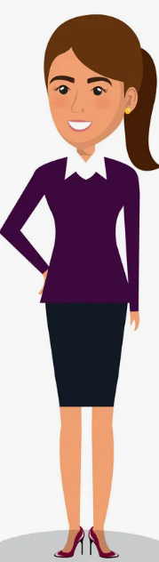
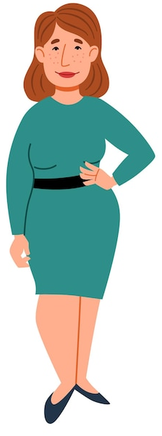
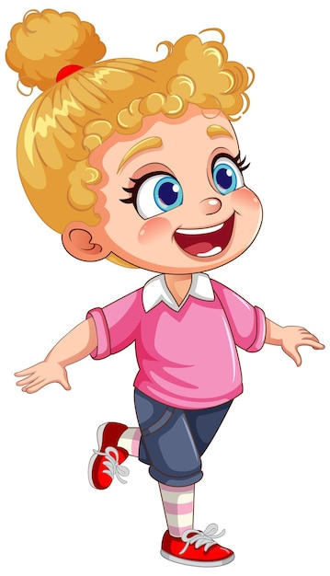
Read the description and guess the person!
My aunt is beautiful.
She is kind. She is thin and tall. She has short fair hair. Her eyes are big and blue. Where is she?
№1
№2
№3

Slide 19

That's right.
Let's watch the video
https://rutube.ru/video/c275702dc024f322fec7a59cc2892061/?r=plwd

Slide 20
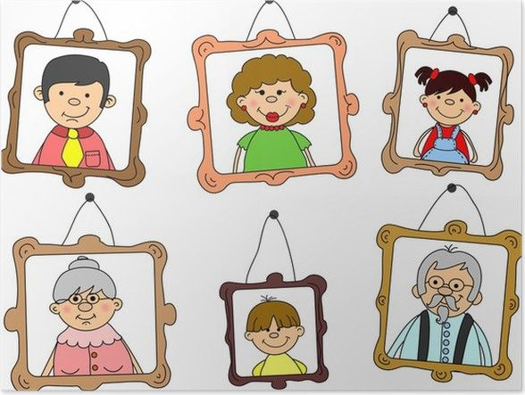
Family Portrait
This is my_______.
His/Her name is_________.
She/He is _____ years old.
He/She is ________. (qualities)
He/She has got_______ eyes.
He/she has got _______ hair.
He/She is ________. (height/ weight)
He/She can ________.
He/She can’t _______.
I love _______ very much!

Slide 21
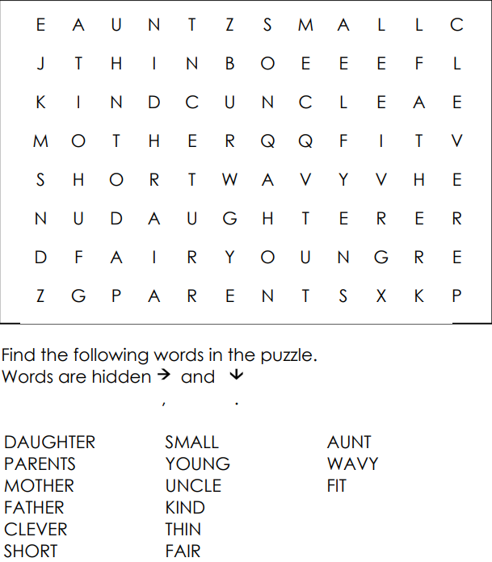
Find the necessary words

Slide 22
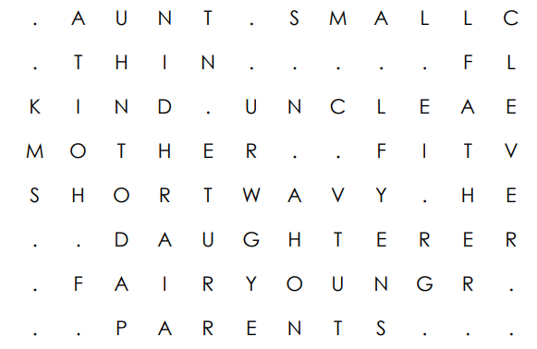
Check yourself
ATTENTION!
These are the right answers

Slide 23

Thank you for the lesson!

Slide 24
Используемые источники:
https://stihi.ru/2013/08/23/1354 - слайд №2
http://kenglish.ru/korotkie-stixi-na-temu-semya-family/ - слайд №2
https://rutube.ru/video/c275702dc024f322fec7a59cc2892061/?r=plwd – слайд №19

Slide 25
This is wrong.
Try again!

