Slide 1

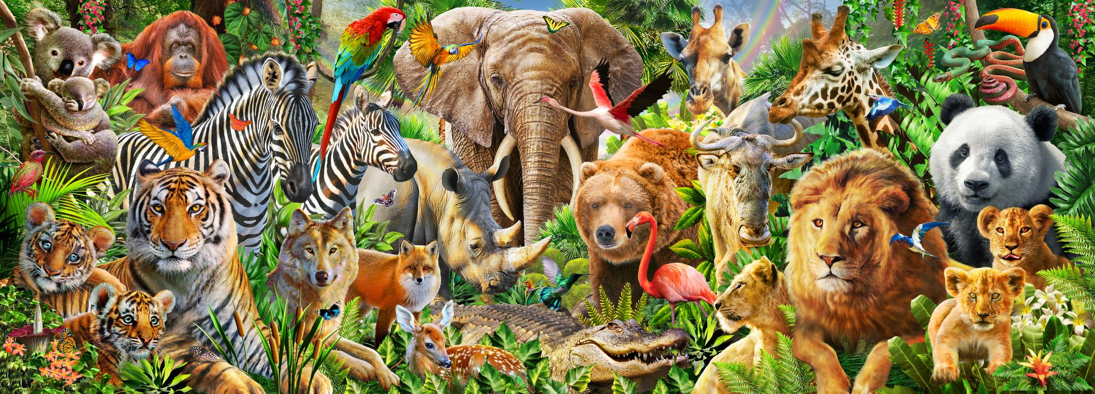
A n I m a l s
Презентация к уроку по учебному предмету «Английский язык» в 4-ом классе на тему:
2024 год

Slide 2
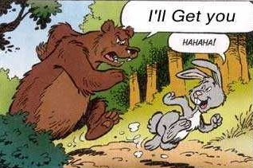
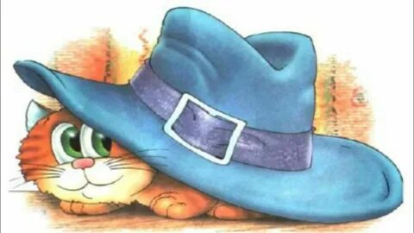
Let's practice
I’m hare,
I run around the bear.
I’m small.
The bear can’t
Catch me at all.
Fat Pat had a fat cat.
Pat’s fat cat sat in Pat’s hat.
A cat in a hat.
A hat in a hand.

Slide 3
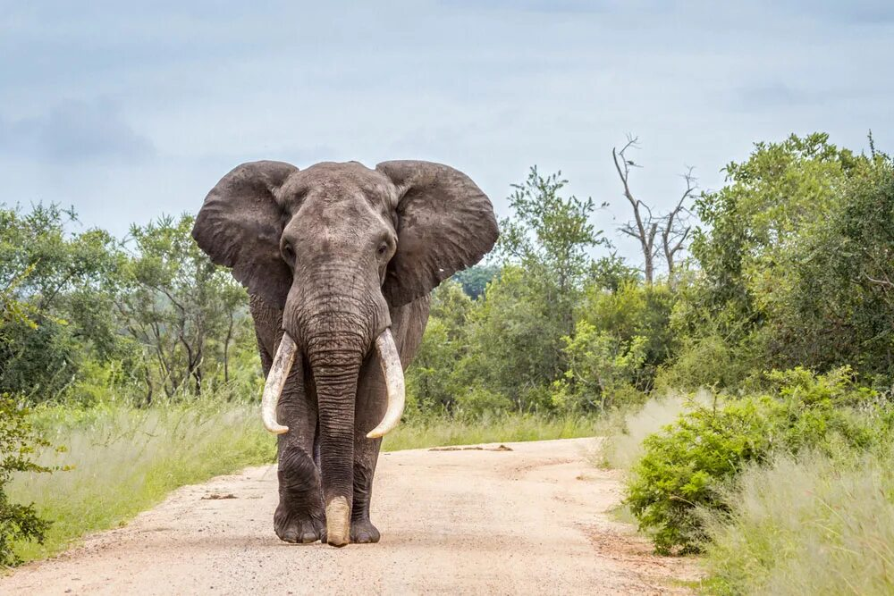

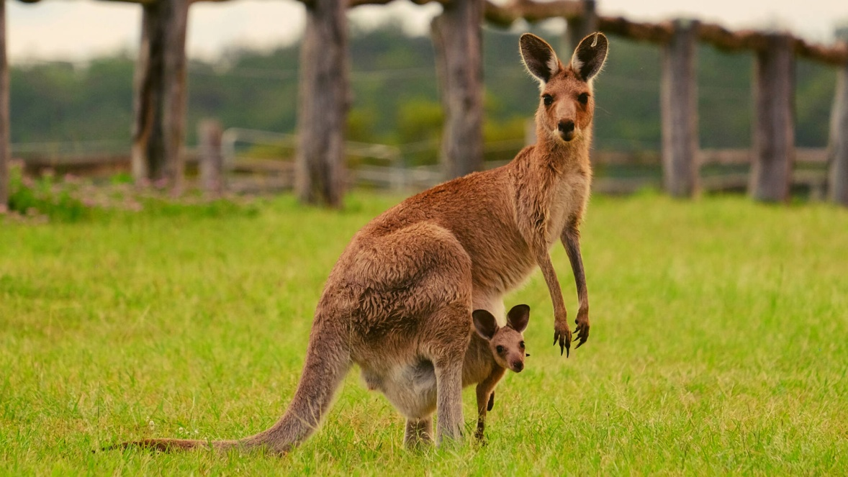
Let's get acquainted
Kangaroo
Elephant

Slide 4
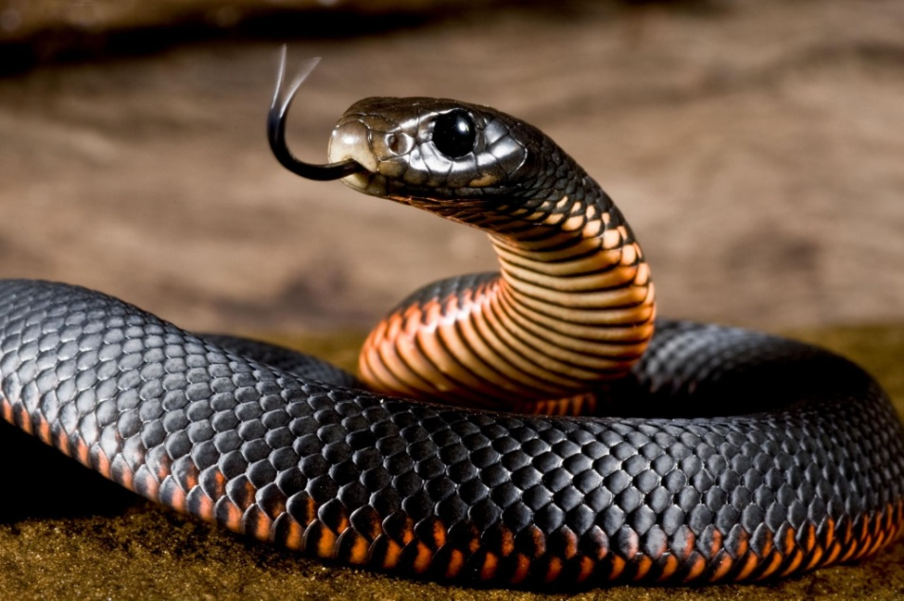
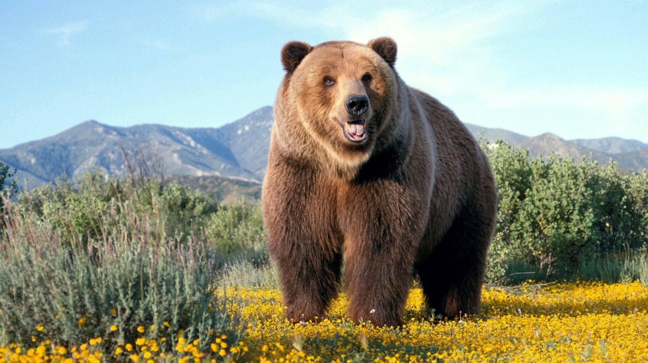
Snake
Bear

Slide 5
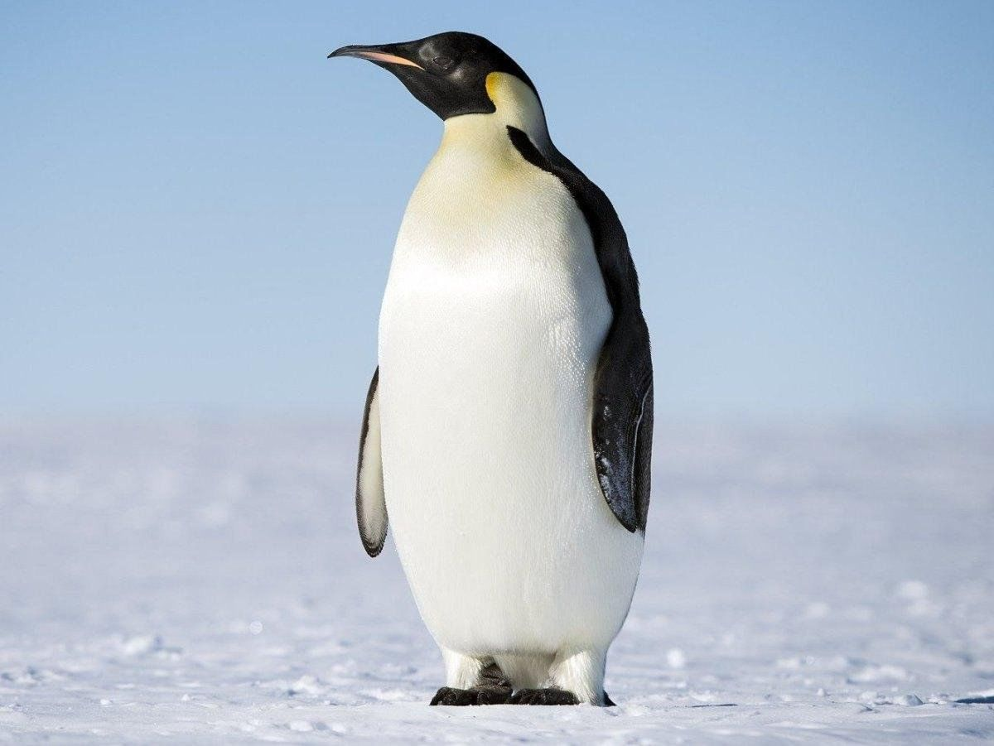
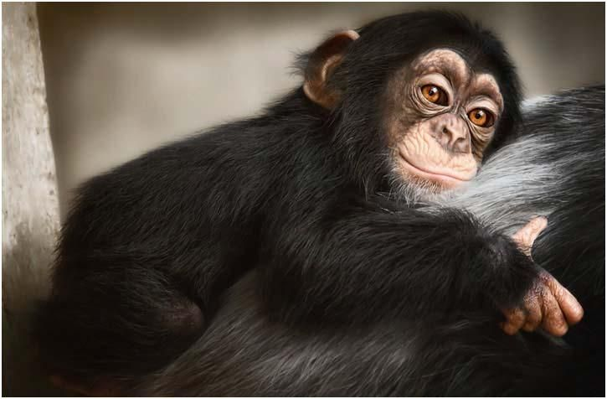
Penguin
Monkey

Slide 6
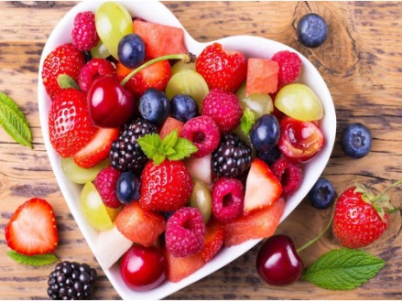
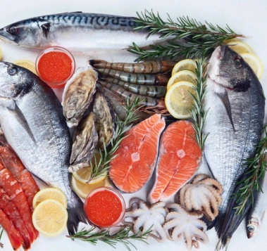
Their favorite food
An elephant
A kangaroo
A monkey
A penguin
A bear
leaves
berries
fruit
fish
meat
eats

Slide 7
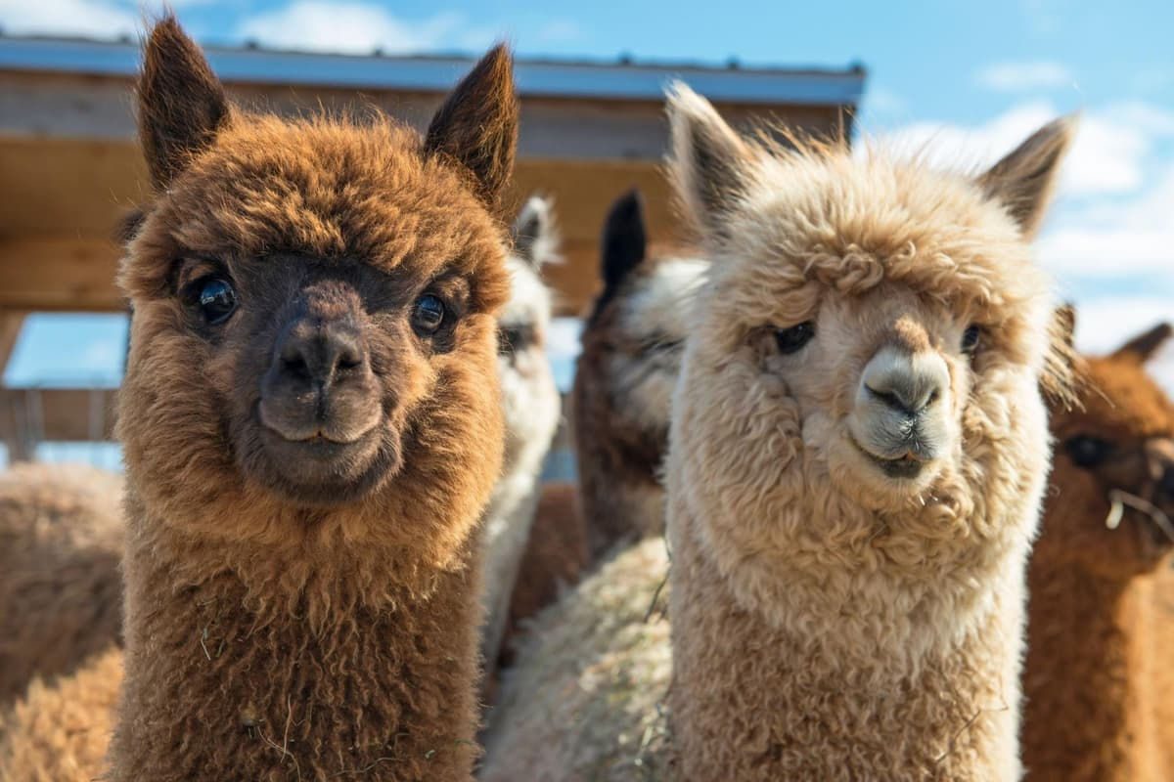
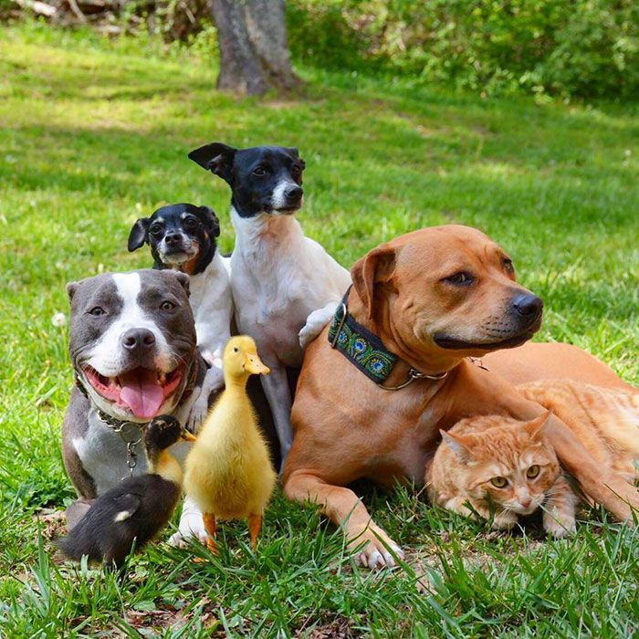
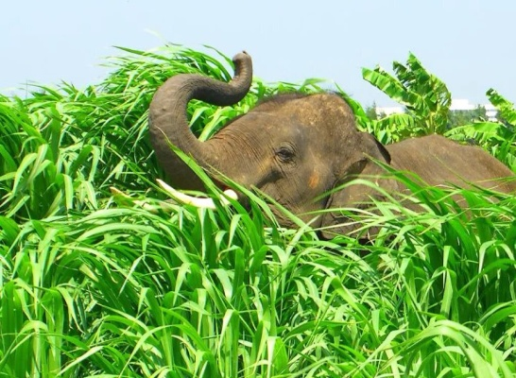
Describe the animals
The animal (it) is ___________ .
friendly
dangerous
big
small
fast
slow
kind
furry
wild
herbivorous

Slide 8
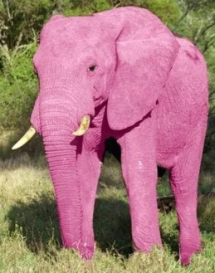
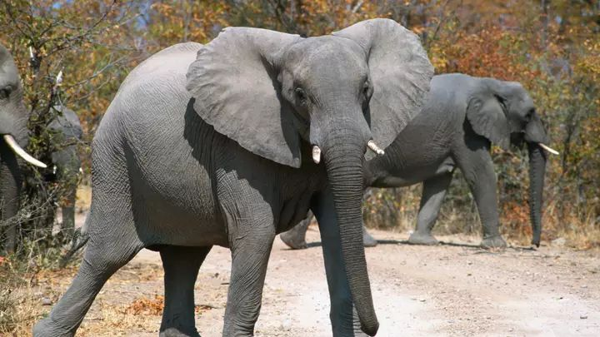
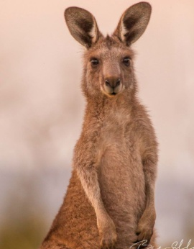
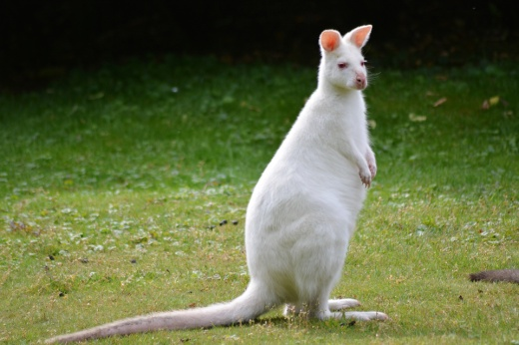
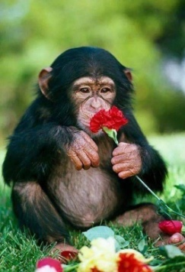
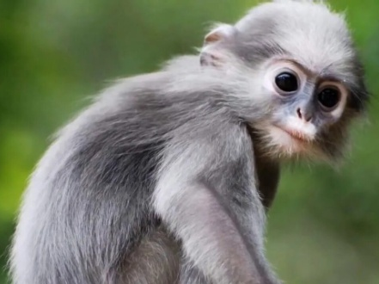
What about their color?
An elephant can be pink or grey.
A kangaroo can be brown or white.
A monkey can be black or grey.

Slide 9
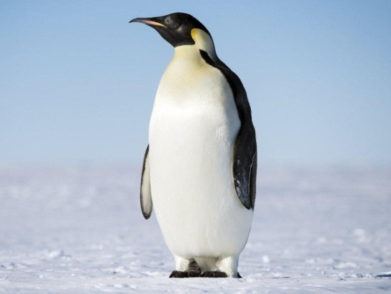
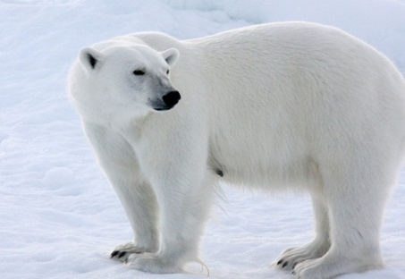
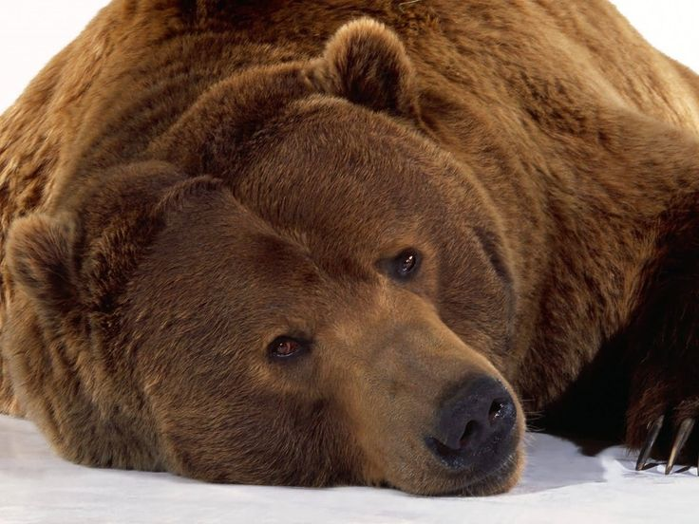
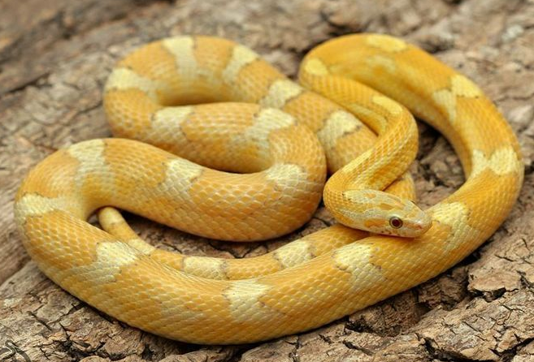
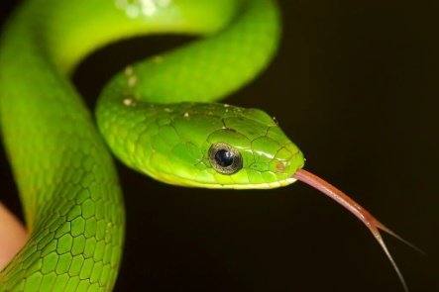
A penguin can be white - black
A bear can be white or brown
A snake can be green or yellow

Slide 10
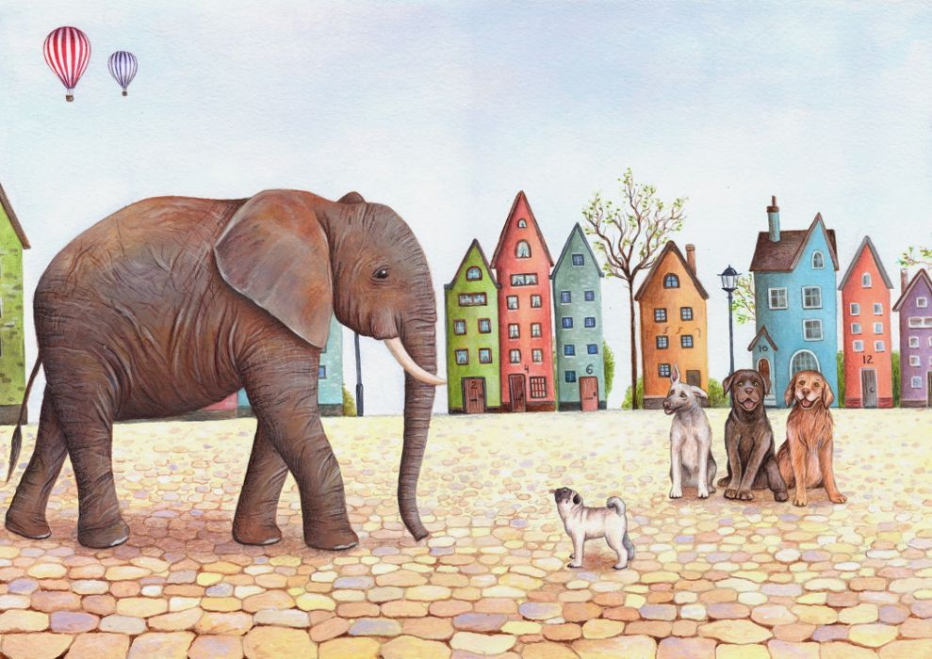
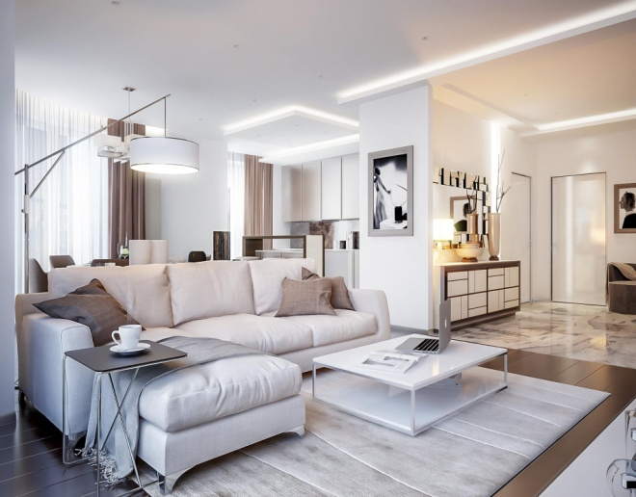
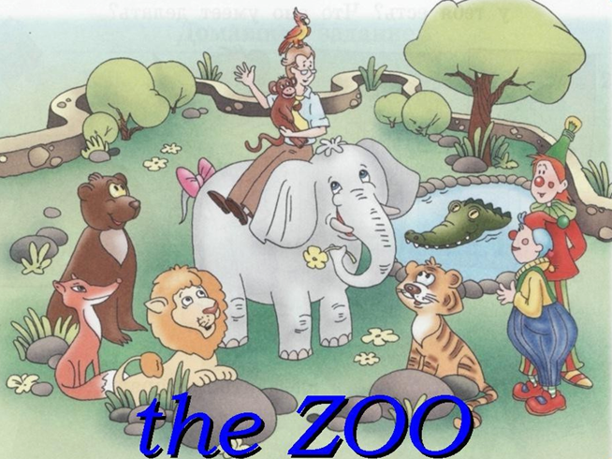
Your opinion
Where can you meet these animals ?
I can meet these animals__________ .
on the street
in the apartment
at the zoo

Slide 11

That's right.
Let's watch the video
https://rutube.ru/video/55a7055d5c15844ecb41fb76ad5817f9/?r=plwd

Slide 12

True or False?
STATEMENTS | TRUE | FALSE
Elephants jump.
Kangaroos waddle.
Monkeys swing.
Penguins stomp.
Snakes slither.
Polar bears swim.

Slide 13
Check yourself
STATEMENTS | TRUE | FALSE
Elephants jump.
Kangaroos waddle.
Monkeys swing.
Penguins stomp.
Snakes slither.
Polar bears swim.
Attention!
These are the right answers!

Slide 14
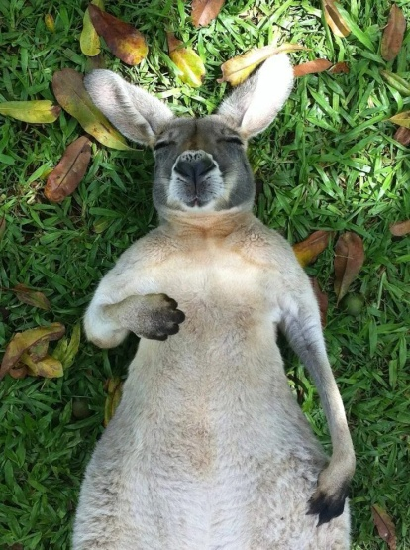
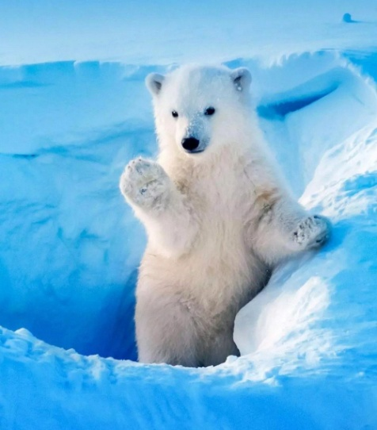
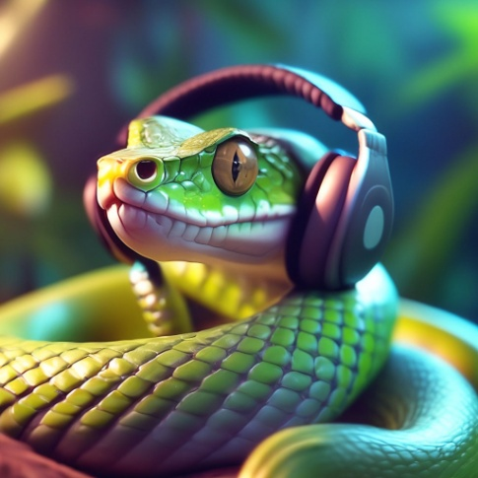
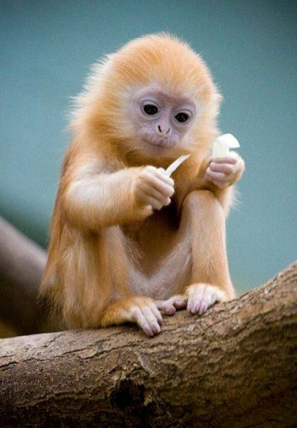
Make a short story about an animal
Example:
It is a ________.
Its name is________.
It is ___ years old.
It is _____ (color).
It eats ______.
I can see it at the zoo.
It can _____ and ____.
But it can't ________.
It is ____and ____ (adjectives).

Slide 15
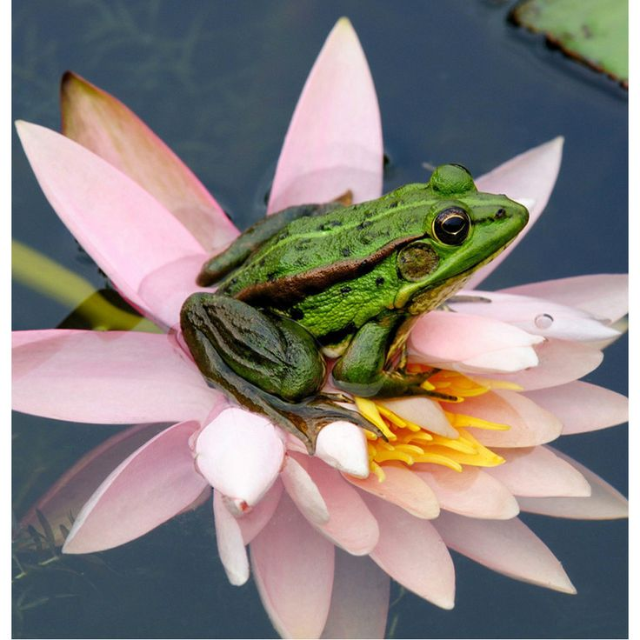
A riddle
?
I live in the river.
I am not a fish.
I jump in the field.
I am not a rabbit.
I have a green coat.
I am not a bird.
I sleep in the day-time.
I am not an owl.
I come out of an egg.
I am not a chick.
I am a frog!
What am I?

Slide 16
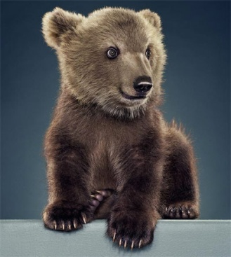
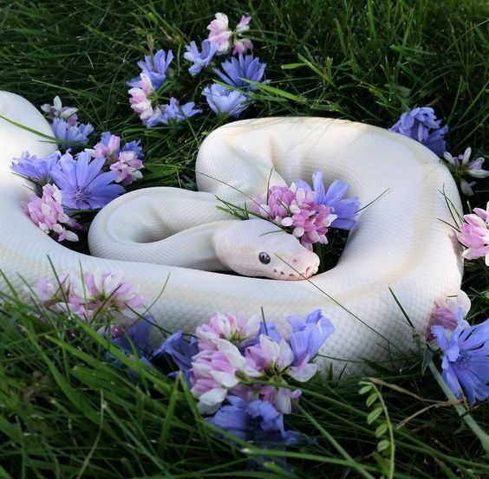
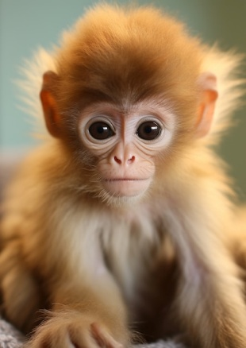
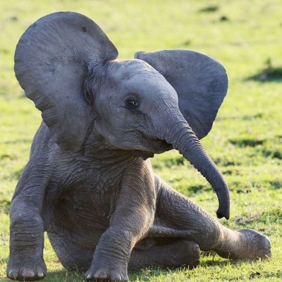
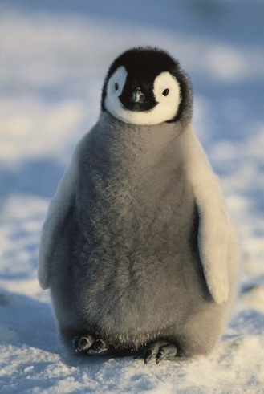
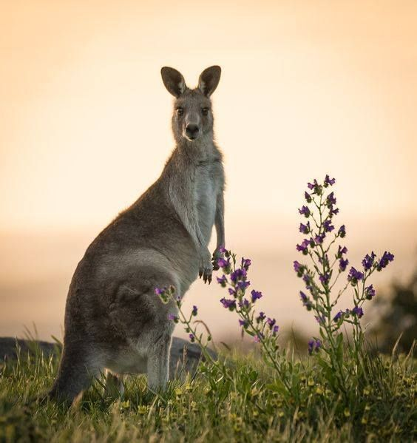
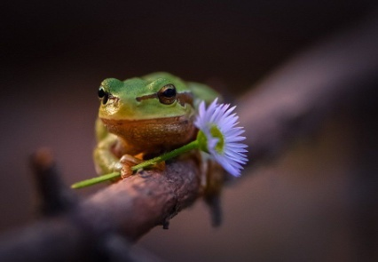
Crossword
3
 |  |  |  |  |  | 7
 |  |  |  | 2
 |  | 3
1
 |  |  |  |  |  |  | 5
 |  | 4
 |  | 6
4
6
5
2
7
1

Slide 17

Check yourself
 |  |  |  |  |  | 7
 |  |  |  |  |  | k
 |  |  |  |  |  | a
 |  |  |  |  |  | n
 |  |  |  | 2 |  | g
 |  |  |  | p |  | a
 |  | 3 | b | e | a | r
 |  |  |  | n |  | o
1 | f | r | o | g |  | o
 |  |  |  | u
 |  |  |  | i |  |  | 5
 |  | 4 | s | n | a | k | e
 |  |  |  |  |  |  | l
 |  | 6 | m | o | n | k | e | y
 |  |  |  |  |  |  | p
 |  |  |  |  |  |  | h
 |  |  |  |  |  |  | a
 |  |  |  |  |  |  | n
 |  |  |  |  |  |  | t

Slide 18
Thank you for the lesson!

Slide 19
Используемые источники
https://rutube.ru/video/55a7055d5c15844ecb41fb76ad5817f9/?r=plwd
Малинина А. А. Английский язык. Занимательное чтение с упражнениями для младших школьников. – Минск: Аверсэв, 2015. – 111с.

