Slide 1
Презентация
к уроку по учебному предмету
«Английский язык»
во 2-ом классе
на тему:
«My Family. My House».
разработана учителем английского языка, методистом
ГБОУ г.Москвы «Школа № 1575»
Юриной Марией Юрьевной

Slide 2
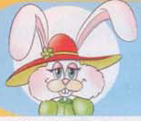
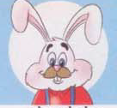

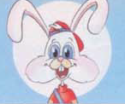
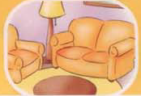
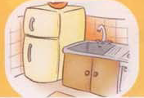
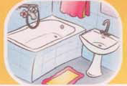
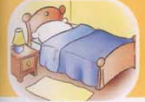
Revision of the topical vocabulary
Task 1. Fill in the gaps and complete the words on topic:
u
y
1) m __ m m __
a
y
i
t
o
e
2) d __ d d __
3) s __ s __ er
4) br __ th __ r
i
i
i
e
a
o
o
e
o
o
5) l __ v __ n g room
6) k __ t ch __ n
7) b __ th r __ __ m
8) b __ d r __ __ m

Slide 3
Task 2. Spell the words on topic and put them down into your exercise-books.
Underline the wovels:
1. мама -
mummy
2. папа -
daddy
3. сестра -
sister
4. брат -
brother
5. гостиная -
living room
6. кухня -
kitchen
7. ванная -
bathroom
8. спальня -
bedroom

Slide 4
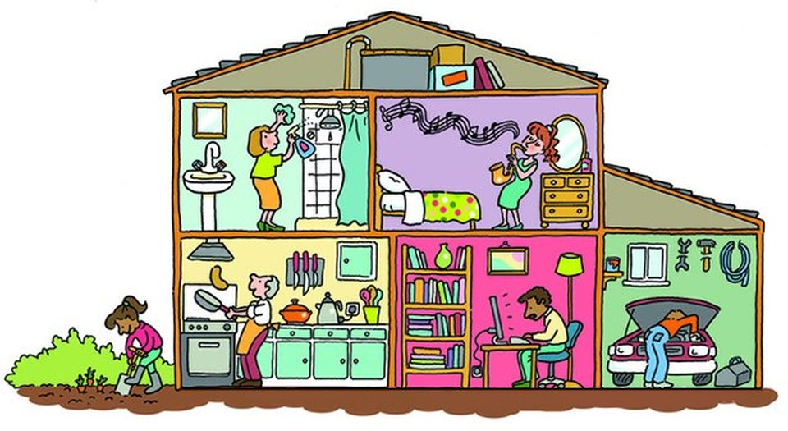
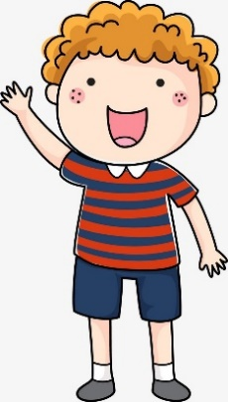
Task 3. Look at the picture. Read and complete the text about the members of Nick’s family:
Nick
This is Nick’s house. His 0) grandfather is in the kitchen. Nick’s younger sister is in the 1) ___________. His 2) ____________ is in the garage. Look! He is fixing the car. Nick’s elder 3) ___________ is in the bedroom. She is playing the music. His grandmother is cleaning the 4) ___________ and his grandfather is cooking in the
5) ____________ . Nick’s 6) _____________ is working in the living room.
garden
brother
sister
bathroom
kitchen
daddy

Slide 5
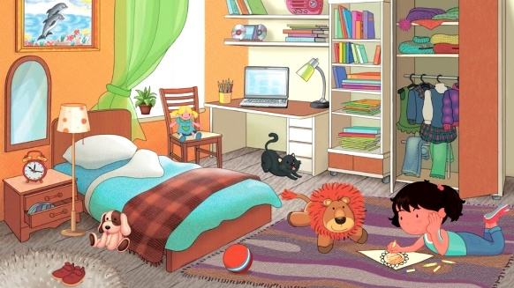
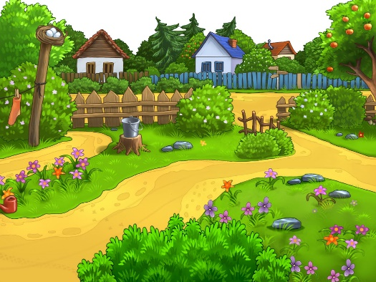
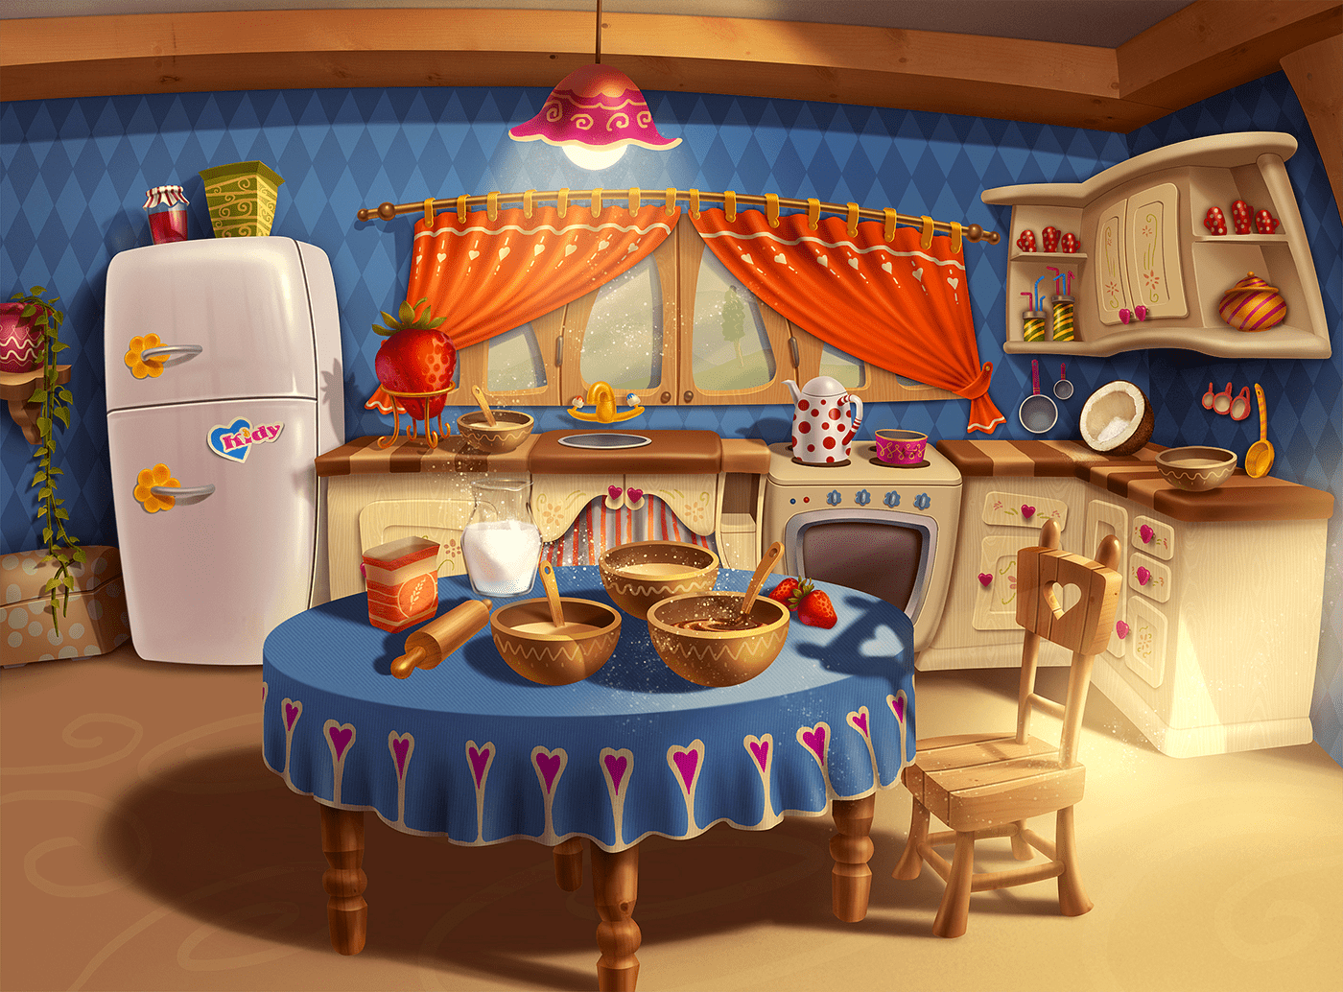
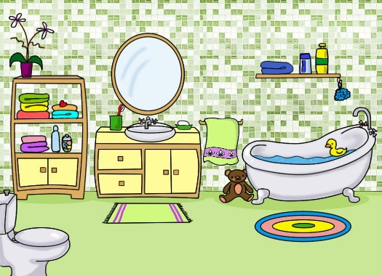
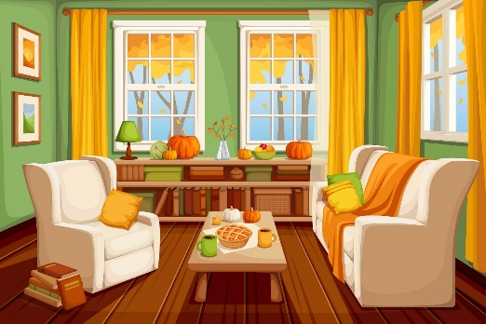
Task 4. Match the pictures to the words on topic:
1) a bathroom
2) a living room
3) a bedroom
4) a kitchen
5) a garden

Slide 6
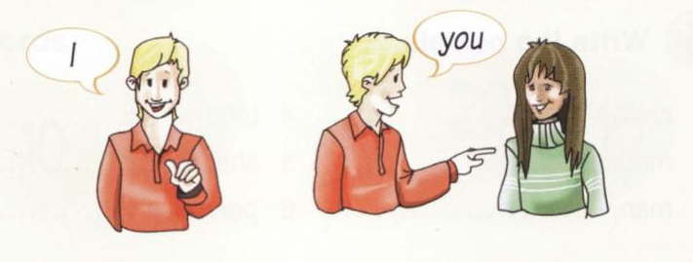
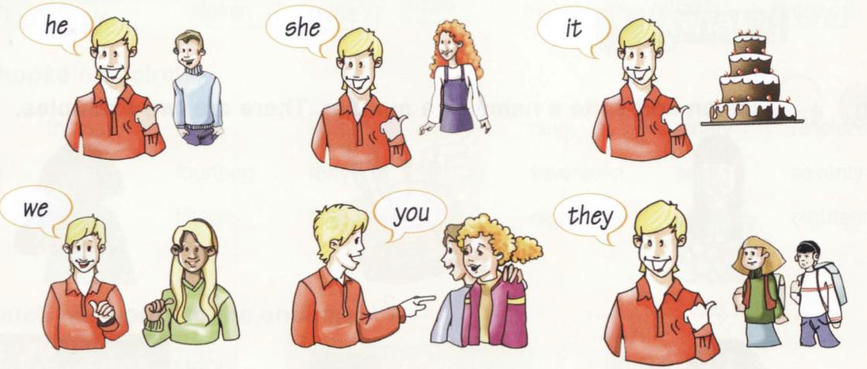
Revision of the personal pronouns and the verb “to be”
Task.5. Read and translate:
Я
Ты
Он
Она
Он (о предмете)
Мы
Вы
Они

Slide 7
Task 6. Use the personal pronouns to replace the words on topic “My Family. My House”:
1) a garden -
it
2) a sister -
she
3) a brother -
he
4) Nick and I -
we
5) Nick and Ann -
they
6) a brother and a sister -
they
7) two bedrooms -
they
8) Ann -
she
9) Nick -
he
10) Ann and you -
you

Slide 8
Task 7. Group the words according to the pronouns.
he
she
it
you
we
they
a living room
a sister
Mary
a mummy
a dog
Mary and you
Nick
My mummy and I
a kitchen
Nick and Mary
a garden
cats
you and I
a brother

Slide 9
The verb “To be” – быть, существовать
Present Simple
☺ | + (утверждение) | ? (вопрос) | - (отрицание)
I (я) | ☺ + am. | Am + ☺ ? | ☺ + am + not.
He (он) She (она) It (оно) | ☺ + is. | Is + ☺ ? | ☺ + is + not.
We (мы) You (ты, вы) They (они) | ☺ + are. | Are + ☺ ? | ☺ + are + not.

Slide 10
Task 7. Use the proper form of the verb “to be” (is / am / are) and complete the text.
Hi! My name 1) ________ Ann. I 2) _________ eight. I am from Russia. This 3) ________ my family. It 4) _________ big. There 5) _________ five of us in my family: my mummy, my daddy, my brother and my elder sister. My mummy’s name 6) _________ Mary. She 7) __________ kind and beautiful. She 8) _________ in the kitchen now. My daddy’s name 9) _________ Alex. He 10) __________ clever and strict. He is in the garage now. This is my sister. Her name 11) _________ Nina. She 12) __________ at school at the moment. And this is my brother Nick. Look! He is watering the flowers in the garden now. Nick 13) _________ cool! We 14) _________ true friends. I love my family and they love me too! My family 15) _________ the best!
is
am
is
is
are
is
is
is
is
is
is
is
is
are
is

Slide 11

And what about your family?
Has your family got a house?
Be ready to answer these questions next time and see you later!

